Slide 1

B2B Library Wireframe
Ver. 2.8 2011.10.31
작성자 | : 최일래, 도진아
Last Update | : 2011.10.31

Slide 2
방송 메인 / 리스트 / 상세화면

Slide 3
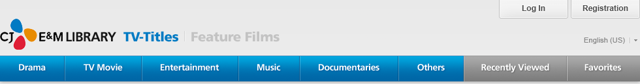
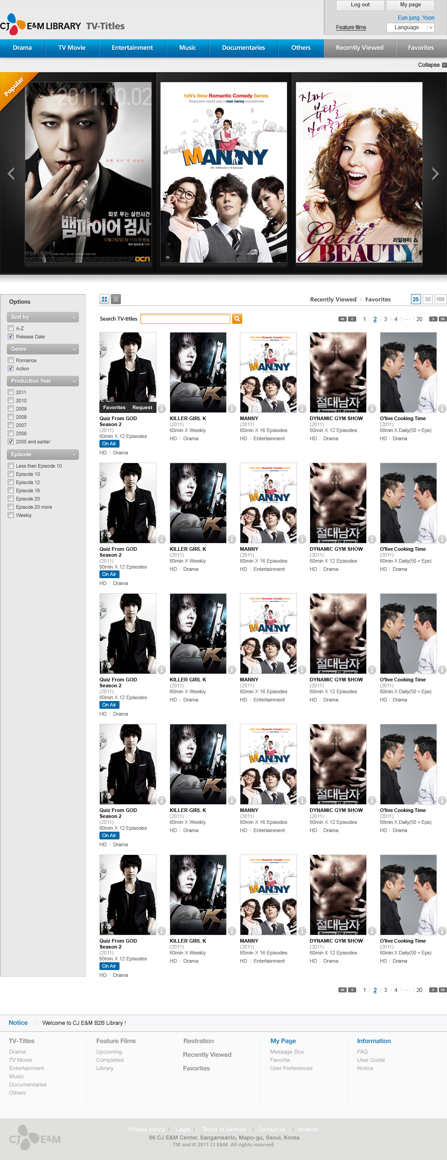









TV-Titles
Feature Films
Options
Recently Viewed
Favorites
25
50
100
Search TV-Titles
Total Titles : 125
Sort by
1 / 5
A – Z
Release date
Episodes
All
Up to 12 Episodes
12 -24 Episodes
Over 25Episodes
Weekly
Format
Dynamic Gum Show (2011)
60min X 12 episodes
HD | Entertainment
Super Star K, season 3 (2011)
60min X 12 episodes
HD | Entertainment
All
HD
SD
[Hot Clips] Get it beauty | Preview
more
Quiz From God, season2 (2011)
60min X 12 episodes
HD | Entertainment
Channel : tvN
Cast : Ryu Duk Hwan, Yoon Joo Hee, Choi Jung Woo
Concept
To us, a rare disease is like a quiz from god.
A quiz from God that keeps us humans from being too proud and arrogant… It’s something that’s left for us to solve…
The Drama deals with criminal cases and rare disease such as porphyria, phenylketonuria and …
QUIZ FROM GOD, season2 (2011)
60min X 12 episodes
HD | Drama
Killer Girl K (2011)
60min X 12 episodes
HD | Drama
Manny (2011)
60min X 12 episodes
HD | Documentaries
Dynamic Gum Show (2011)
60min X 12 episodes
HD | Entertainment
Super Star K, season 3 (2011)
60min X 12 episodes
HD | Entertainment
QUIZ FROM GOD, season2 (2011)
60min X 12 episodes
HD | Drama
Killer Girl K (2011)
60min X 12 episodes
HD | Drama
Manny (2011)
60min X 12 episodes
HD | Documentaries
Dynamic Gum Show (2011)
60min X 12 episodes
HD | Entertainment
Super Star K, season 3 (2011)
60min X 12 episodes
HD | Entertainment

Slide 4
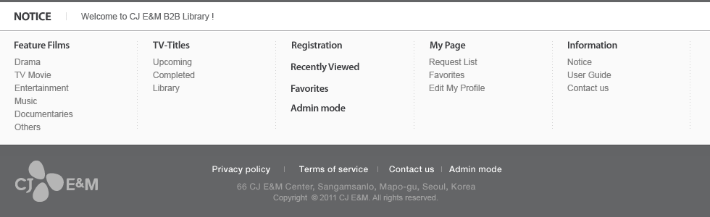
QUIZ FROM GOD, season2 (2011)
60min X 12 episodes
HD | Drama
Killer Girl K (2011)
60min X 12 episodes
HD | Drama
Manny (2011)
60min X 12 episodes
HD | Documentaries
Dynamic Gum Show (2011)
60min X 12 episodes
HD | Entertainment
Super Star K, season 3 (2011)
60min X 12 episodes
HD | Entertainment
QUIZ FROM GOD, season2 (2011)
60min X 12 episodes
HD | Drama
Killer Girl K (2011)
60min X 12 episodes
HD | Drama
Manny (2011)
60min X 12 episodes
HD | Documentaries
Dynamic Gum Show (2011)
60min X 12 episodes
HD | Entertainment
Super Star K, season 3 (2011)
60min X 12 episodes
HD | Entertainment
QUIZ FROM GOD, season2 (2011)
60min X 12 episodes
HD | Drama
Killer Girl K (2011)
60min X 12 episodes
HD | Drama
Manny (2011)
60min X 12 episodes
HD | Documentaries
Dynamic Gum Show (2011)
60min X 12 episodes
HD | Entertainment
Super Star K, season 3 (2011)
60min X 12 episodes
HD | Entertainment

Slide 5
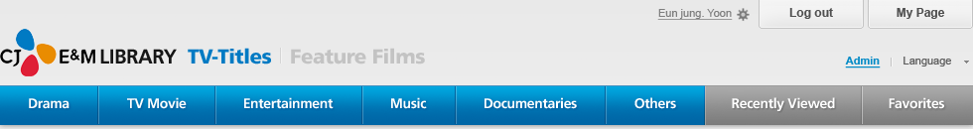

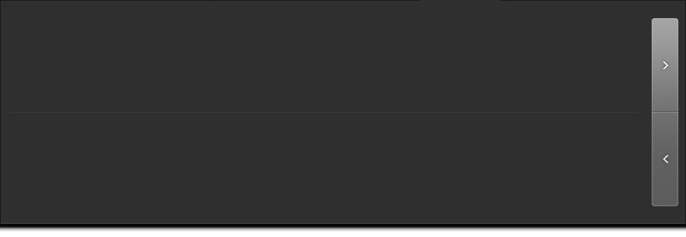








TV-Titles
Feature Films
Recently Viewed
30/ total: 30
M! Count Down
90min X Weekly
HD | Drama
M! Count Down
90min X Weekly
HD | Drama
M! Count Down
90min X Weekly
HD | Drama
M! Count Down
90min X Weekly
HD | Drama
M! Count Down
90min X Weekly
HD | Drama
M! Count Down
90min X Weekly
HD | Drama
M! Count Down
90min X Weekly
HD | Drama
M! Count Down
90min X Weekly
HD | Drama
M! Count Down
90min X Weekly
HD | Drama
M! Count Down
90min X Weekly
HD | Drama
Options
Recently Viewed
Favorites
25
50
100
Search TV-Titles
Total Titles : 125
Sort by
1 / 5
A – Z
Release date
Episodes
All
Up to 12 Episodes
12 -24 Episodes
Over 25Episodes
Weekly
Format
Dynamic Gum Show (2011)
60min X 12 episodes
HD | Entertainment
Super Star K, season 3 (2011)
60min X 12 episodes
HD | Entertainment
All
HD
SD
[Hot Clips] Get it beauty | Preview
more
QUIZ FROM GOD, season2 (2011)
60min X 12 episodes
HD | Drama
Killer Girl K (2011)
60min X 12 episodes
HD | Drama
Manny (2011)
60min X 12 episodes
HD | Documentaries
Dynamic Gum Show (2011)
60min X 12 episodes
HD | Entertainment
Super Star K, season 3 (2011)
60min X 12 episodes
HD | Entertainment
QUIZ FROM GOD, season2 (2011)
60min X 12 episodes
HD | Drama
Killer Girl K (2011)
60min X 12 episodes
HD | Drama
Manny (2011)
60min X 12 episodes
HD | Documentaries
Dynamic Gum Show (2011)
60min X 12 episodes
HD | Entertainment
Super Star K, season 3 (2011)
60min X 12 episodes
HD | Entertainment

Slide 6
TV-Titles
Feature Films
Favorites
TV- Titles | Feature Films
M! Count Down
90min X Weekly
HD | Drama
Add: 10.24.2011
M! Count Down
90min X Weekly
HD | Drama
Add: 10.24.2011
M! Count Down
90min X Weekly
HD | Drama
Add: 10.24.2011
M! Count Down
90min X Weekly
HD | Drama
Add: 10.24.2011
M! Count Down
90min X Weekly
HD | Drama
Add: 10.24.2011
M! Count Down
90min X Weekly
HD | Drama
Add: 10.24.2011
M! Count Down
90min X Weekly
HD | Drama
Add: 10.24.2011
M! Count Down
90min X Weekly
HD | Drama
Add: 10.24.2011
M! Count Down
90min X Weekly
HD | Drama
Add: 10.24.2011
M! Count Down
90min X Weekly
HD | Drama
Add: 10.24.2011
Options
Recently Viewed
Favorites
25
50
100
Search TV-Titles
Total Titles : 125
Sort by
1 / 5
A – Z
Release date
Episodes
All
Up to 12 Episodes
12 -24 Episodes
Over 25Episodes
Weekly
Format
Dynamic Gum Show (2011)
60min X 12 episodes
HD | Entertainment
Super Star K, season 3 (2011)
60min X 12 episodes
HD | Entertainment
All
HD
SD
[Hot Clips] Get it beauty | Preview
more
Quiz From God, season2 (2011)
60min X 12 episodes
HD | Entertainment
Channel : tvN
Cast : Ryu Duk Hwan, Yoon Joo Hee, Choi Jung Woo
Concept
To us, a rare disease is like a quiz from god.
A quiz from God that keeps us humans from being too proud and arrogant… It’s something that’s left for us to solve…
The Drama deals with criminal cases and rare disease such as porphyria, phenylketonuria and …
QUIZ FROM GOD, season2 (2011)
60min X 12 episodes
HD | Drama
Killer Girl K (2011)
60min X 12 episodes
HD | Drama
Manny (2011)
60min X 12 episodes
HD | Documentaries
Dynamic Gum Show (2011)
60min X 12 episodes
HD | Entertainment
Super Star K, season 3 (2011)
60min X 12 episodes
HD | Entertainment
QUIZ FROM GOD, season2 (2011)
60min X 12 episodes
HD | Drama
Killer Girl K (2011)
60min X 12 episodes
HD | Drama
Manny (2011)
60min X 12 episodes
HD | Documentaries
Dynamic Gum Show (2011)
60min X 12 episodes
HD | Entertainment
Super Star K, season 3 (2011)
60min X 12 episodes
HD | Entertainment

Slide 7
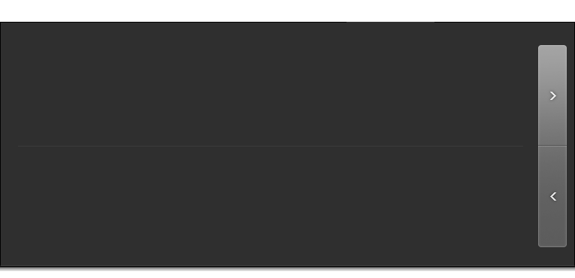
TV-Titles
Feature Films
Options
Recently Viewed
Favorites
25
50
100
30/ total: 30
Recently Viewed
Search TV-Titles
Total Titles : 125
Sort by
QUIZ FROM GOD,season2 (2011)
60min X 12 episodes
HD | Drama
M! Count Down
90min X Weekly
HD | Drama
M! Count Down
90min X Weekly
HD | Drama
1 / 5
A – Z
Release date
Once Upon A Time In Sanctuary (2011)
60min X 12Ep
HD | Entert..
Episodes
All
Up to 12 Episodes
12 -24 Episodes
Over 25Episodes
Weekly
M! Count Down
90min X Weekly
HD | Drama
M! Count Down
90min X Weekly
HD | Drama
M! Count Down
90min X Weekly
HD | Drama
M! Count Down
90min X Weekly
HD | Drama
Format
Dynamic Gum Show (2011)
60min X 12 episodes
HD | Entertainment
Super Star K, season 3 (2011)
60min X 12 episodes
HD | Entertainment
All
HD
SD
[Hot Clips] Get it beauty | Preview
more
Quiz From God, season2 (2011)
60min X 12 episodes
HD | Entertainment
Channel : tvN
Cast : Ryu Duk Hwan, Yoon Joo Hee, Choi Jung Woo
Concept
To us, a rare disease is like a quiz from god.
A quiz from God that keeps us humans from being too proud and arrogant… It’s something that’s left for us to solve…
The Drama deals with criminal cases and rare disease such as porphyria, phenylketonuria and …
QUIZ FROM GOD, season2 (2011)
60min X 12 episodes
HD | Drama
Killer Girl K (2011)
60min X 12 episodes
HD | Drama
Manny (2011)
60min X 12 episodes
HD | Documentaries
Dynamic Gum Show (2011)
60min X 12 episodes
HD | Entertainment
Super Star K, season 3 (2011)
60min X 12 episodes
HD | Entertainment
QUIZ FROM GOD, season2 (2011)
60min X 12 episodes
HD | Drama
Killer Girl K (2011)
60min X 12 episodes
HD | Drama
Manny (2011)
60min X 12 episodes
HD | Documentaries
Dynamic Gum Show (2011)
60min X 12 episodes
HD | Entertainment
Super Star K, season 3 (2011)
60min X 12 episodes
HD | Entertainment

Slide 8
Options
Recently Viewed
Favorites
25
50
100
Sort by
Search TV-Titles
1 / 5
A – Z
Release date
Episodes
1 | Quiz From God (2011) | 60min X 8episodes | HD | Documentaries
2 | In Needs Of Romance | 60min X 16 episodes | SD | Drama
3 | Style Icon Awards, SIA | 150min X 1episodes | HD | TV Movie
4 | 20’s Choice | 180min X 1episode | HD | Entertainment
5 | Mnet Asian Music Awards, MAMA | 240mins X 1 episodes | HD | Others
6 | M Super Concert | 60min – 90min | HD | Music
7 | A-LIVE | 60min X 18episodes | HD | Documentaries
8 | MUST | 90min X Weekly | HD | Drama
9 | Get it Beauty | 60min X Weekly | HD | TV Movie
10 | Dynamic Gym Show | 60min X 14 episodes | HD | Entertainment
11 | Home Made Cook | 30min X Daily (30 + Eps) | HD | Others
12 | Once Upon a Time in Sanctuary | 60min X 12episodes | HD | Music
13 | The Detective, Jung Yack-Yong | 60min X 8episodes | HD | Documentaries
14 | MUST | 90min X Weekly | HD | Drama
15 | Get it Beauty | 60min X Weekly | HD | TV Movie
16 | Dynamic Gym Show | 60min X 14 episodes | HD | Entertainment
17 | Home Made Cook | 30min X Daily (30+Eps) | HD | Others
18 | A Yatsa | 60min X 12episodes | HD | Music
19 | The Detective, Jung Yack-Yong | 60min X 8episodes | HD | Documentaries
20 | In Needs Of Romance | 60min X 16 episodes | SD | Drama
21 | Style Icon Awards, SIA | 150min X 1episodes | HD | TV Movie
22 | Wide Entertainment News | 180min X 1episode | HD | Entertainment
23 | Mnet Asian Music Awards, MAMA | 240mins X 1 episodes | HD | Others
24 | M Super Concert | 240mins X 1 episodes | HD | Music
1234 | A-LIVE | 60min X 18episodes | HD | Documentaries
All
Up to 12 Episodes
12 -24 Episodes
Over 25Episodes
Weekly
Format
All
HD
SD
Once Upon a Time in Sanctuary
(2011)
60min X 12 episodes
HD | Drama
Channel tvN
Cast Ryu Duk Hwan, Yoon Joo Hee, Choi Jung Woo
Concept
To us, a rare disease is like a quiz from god.
A quiz from God that keeps us humans from being too proud and arrogant… It’s something that’s left for us to solve…
The Drama deals with criminal cases and rare disease such as porphyria, phenylketonuria and …

Slide 9

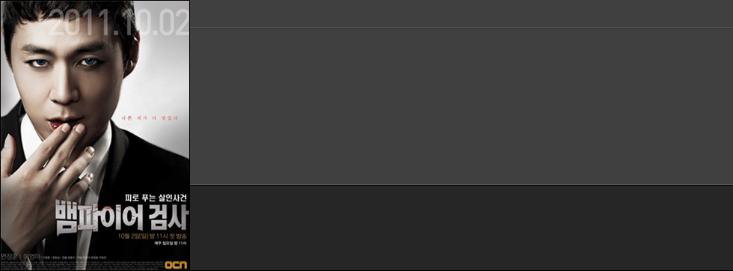
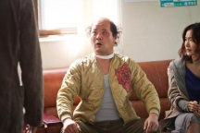
15 and Under
18 and Under
Request Program
| Send to E-mail
| Favorites
Brochure Download
권한신청
In Needs Of Romance
로맨스가 필요해 시즌 1
Drama | 60min X 16episodes | 2011 ( 2011.3.5 ~ )
Channel : tvN | Rating(Korea) : 15 and under
Genre : Romantic Comedy
Cast : Jo Yeo-jung, Kim Jung-hoon, Choi Yeo-jin, Choi song-hyun, Kim Hyung-min
Director / Writer : Lee Chang-han, Jang Hyun-jung
스트리밍을 원하시는 콘텐츠를 적어주시면 관리자가 해당 권한을 부여해 드립니다. 관리자의 승인 시점부터 2주간 권안이 주어지며, 기간 만료 후 이용을 원하시면 재요청하셔야 합니다.
Poster / Images (20)
Multi Media (5)
Episode | Trailer | Making
Ep.01
Trailer
Making
Main / Episodes
Poster · Images (20)
Multi Media (5)
Other Titles
About the Program
This upbeat drama revolves around three women in their early thirties, and tells the story of their love lives, careers and friendship.
Kim Jung Hoon takes on the male lead character Sung Soo and award winning movie actress Jo Yeo Jung as the female lead character In-Young,
an independent, lovable woman struggling to survive in modern-day society.
From the writer and director behind such solid romantic comedies as < I Love You > and < My Sister – in – Law is 19>,
this is a witty and charming affair story, depicting the struggles of contemporary women.
취소
확인
▼ | Episode Title |  | Duration | SCRIPT | RATING (Korean)
1 |  | In Needs Of Romance, Ep.01 | 00:52:17
 |  | SYNOPSIS After helping Carlos conceal his crime, guilt weighs heavily on Susan, Gaby, Bree and Lynette…; CAST Jo Yeo-jung, Kim Jung-hoon, Choi Yeo-jin, Choi song-hyun, Kim Hyung-min CREW Lee Chang-han, Jang Hyun-jung
2 |  | In Needs Of Romance, Ep.02 | 00:52:17
 |  | SYNOPSIS After helping Carlos conceal his crime, guilt weighs heavily on Susan, Gaby, Bree and Lynette…; CAST Jo Yeo-jung, Kim Jung-hoon, Choi Yeo-jin, Choi song-hyun, Kim Hyung-min CREW Lee Chang-han, Jang Hyun-jung
3 |  | In Needs Of Romance, Ep.03 | 00:52:17
 |  | SYNOPSIS After helping Carlos conceal his crime, guilt weighs heavily on Susan, Gaby, Bree and Lynette…; CAST Jo Yeo-jung, Kim Jung-hoon, Choi Yeo-jin, Choi song-hyun, Kim Hyung-min CREW Lee Chang-han, Jang Hyun-jung
4 |  | In Needs Of Romance, Ep.04 | 00:52:17
 |  | SYNOPSIS After helping Carlos conceal his crime, guilt weighs heavily on Susan, Gaby, Bree and Lynette…; CAST Jo Yeo-jung, Kim Jung-hoon, Choi Yeo-jin, Choi song-hyun, Kim Hyung-min CREW Lee Chang-han, Jang Hyun-jung
5 |  | In Needs Of Romance, Ep.05 | 00:52:17
 |  | SYNOPSIS After helping Carlos conceal his crime, guilt weighs heavily on Susan, Gaby, Bree and Lynette…; CAST Jo Yeo-jung, Kim Jung-hoon, Choi Yeo-jin, Choi song-hyun, Kim Hyung-min CREW Lee Chang-han, Jang Hyun-jung
10 |  | In Needs Of Romance, Ep.10 | 00:52:17
 |  | SYNOPSIS After helping Carlos conceal his crime, guilt weighs heavily on Susan, Gaby, Bree and Lynette…; CAST Jo Yeo-jung, Kim Jung-hoon, Choi Yeo-jin, Choi song-hyun, Kim Hyung-min CREW Lee Chang-han, Jang Hyun-jung
General Audiences
12 and Under
Restricted Rating
12 and Under
12 and Under
Restricted Rating

Slide 10
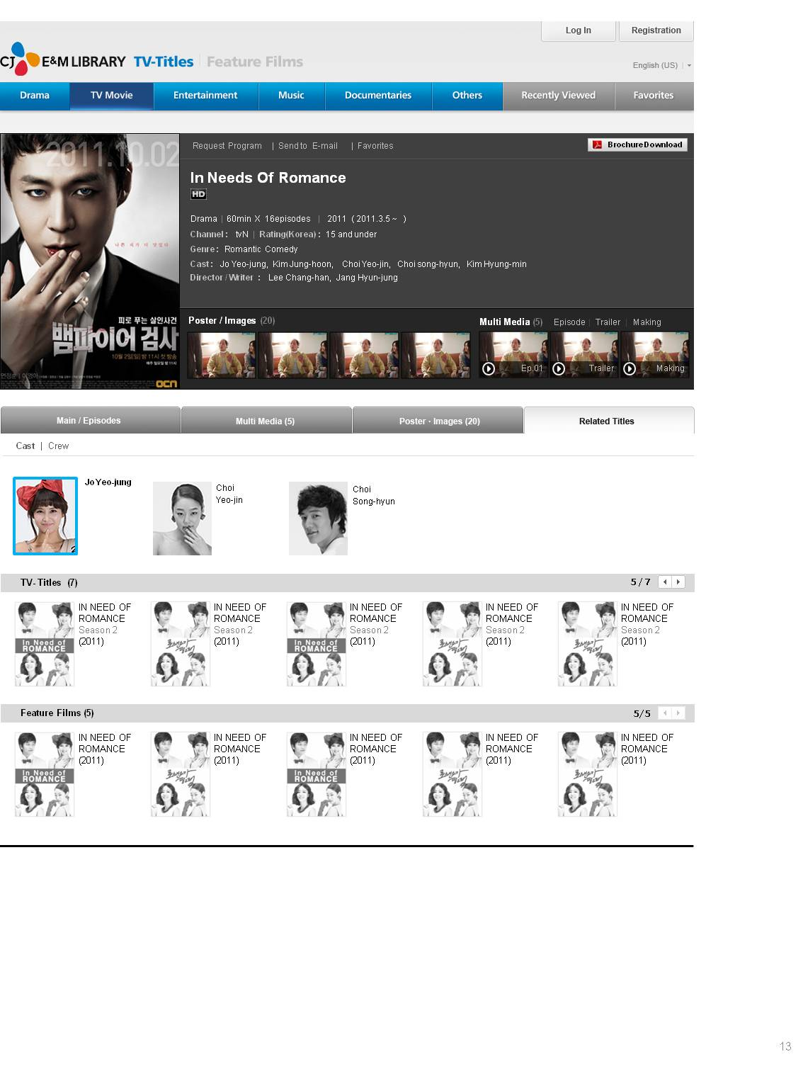
메일 보내기
CJ B2B LIBRARY “로맨스가 필요해 시즌 1”
E-mail
해당 콘텐츠의 상세화면 링크를 입력하신 메일 주소로 보냅니다.
추가로 코멘트할 내용이 있으면 이곳에 입력해 주세요.
취소
확인

Slide 11
영화 메인 / 리스트 / 상세화면

Slide 12

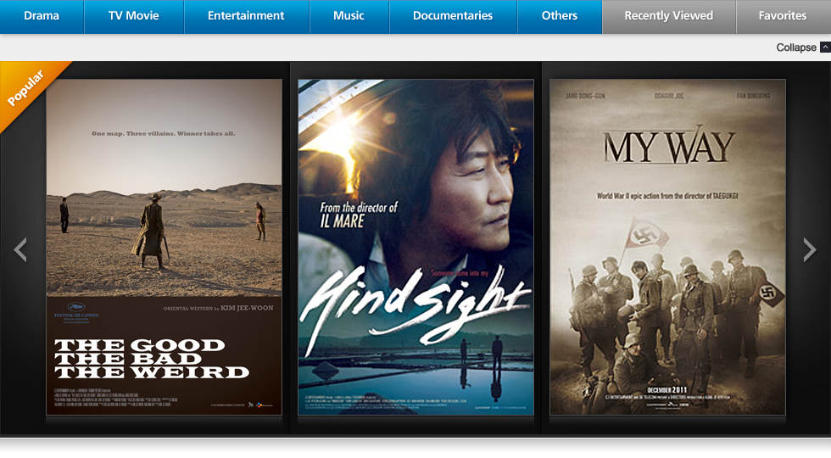

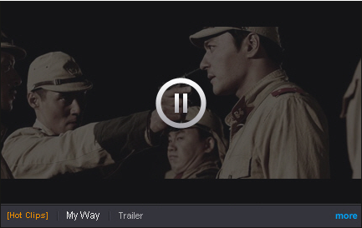






Options
Recently Viewed
Favorites
25
50
100
Sort by
Search Feature films
Total Titles : 125
A – Z
Release date
1 / 5
Genre
All
Action
Adventure
Animation
Comedy
Crime
Drama
Horror
Musical
Oriental Western
Period
Romance
Thriller
A Man Who Was Super Man (2008)
Drama
139min
Once Upon a Time in High School: Spirit.. (2004)
Action, Drama
110min
Production Year
All
2011
2010
2009
2008
2007
2006
2005 before
Once Upon a Time in High School: Spirit of Jeet Kune Do (2004)
Oriental Western | 139 min
Domestic Release Date : 2008.07.17
Director : Yoo Ha
Cast : KWON Sang-woo, LEE Jung-jin, HAN Ga-in
Language : Korean, English,
Synopsis
To us, a rare disease is like a quiz from god.
A quiz from God that keeps us humans from being too proud and arrogant… It’s something that’s left for us to solve… The Drama deals with criminal cases and rare disease such as porphyria, phenylketonuria and …
The Good, The Bad, The Weird (2008)
Oriental Western
139min
Hanbando (2008)
Thriller, Drama, Acti..
139min
Lost and Found (2008)
Romance, Comedy
120min
A Man Who Was Super Man (2008)
Drama
139min
Once Upon a Time in High School: Spirit.. (2004)
Action, Drama
110min
The Good, The Bad, The Weird (2008)
Oriental Western
139min
Hanbando (2008)
Thriller, Drama, Acti..
139min
Lost and Found (2008)
Romance, Comedy
120min
A Man Who Was Super Man (2008)
Drama
139min
Once Upon a Time in High School: Spirit.. (2004)
Action, Drama
110min

Slide 13
The Good, The Bad, The Weird (2008)
Oriental Western
139min
Hanbando (2008)
Thriller, Drama, Acti..
139min
Lost and Found (2008)
Romance, Comedy
120min
A Man Who Was Super Man (2008)
Drama
139min
Once Upon a Time in High School: Spirit.. (2004)
Action, Drama
110min
The Good, The Bad, The Weird (2008)
Oriental Western
139min
Hanbando (2008)
Thriller, Drama, Acti..
139min
Lost and Found (2008)
Romance, Comedy
120min
A Man Who Was Super Man (2008)
Drama
139min
Once Upon a Time in High School: Spirit.. (2004)
Action, Drama
110min
The Good, The Bad, The Weird (2008)
Oriental Western
139min
Hanbando (2008)
Thriller, Drama, Acti..
139min
Lost and Found (2008)
Romance, Comedy
120min
A Man Who Was Super Man (2008)
Drama
139min
Once Upon a Time in High School: Spirit.. (2004)
Action, Drama
110min

Slide 14
Options
Recently Viewed
Favorites
25
50
100
Sort by
Search Feature films
1 / 5
A – Z
Release date
Genre
1 | The Good, The Bad, The Weird (2008) | Oriental Western | 139 min
2 | Hanbando (2008) | Thriller, Drama, Action | 139 min
3 | Lost and Found (2008) | Romance, Comedy | 120 min
4 | A Man Who Was Super Man (2008) | Drama | 110 min
5 | Once Upon a Time in High School: Spirit of Jeet .. (2004) | Action, Drama | 108 min
6 | The Good, The Bad, The Weird (2008) | Oriental Western | 139 min
7 | Hanbando (2008) | Thriller, Drama, Action | 139 min
8 | Lost and Found (2008) | Romance, Comedy | 120 min
9 | A Man Who Was Super Man (2008) | Drama | 110 min
10 | Once Upon a Time in High School: Spirit of Jeet .. (2004) | Action, Drama | 108 min
11 | The Good, The Bad, The Weird (2008) | Oriental Western | 139 min
12 | Hanbando (2008) | Thriller, Drama, Action | 139 min
13 | Lost and Found (2008) | Romance, Comedy | 120 min
14 | A Man Who Was Super Man (2008) | Drama | 110 min
15 | Once Upon a Time in High School: Spirit of Jeet .. (2004) | Action, Drama | 108 min
16 | The Good, The Bad, The Weird (2008) | Oriental Western | 139 min
17 | Hanbando (2008) | Thriller, Drama, Action | 139 min
18 | Lost and Found (2008) | Romance, Comedy | 120 min
19 | A Man Who Was Super Man (2008) | Drama | 110 min
20 | Once Upon a Time in High School: Spirit of Jeet .. (2004) | Action, Drama | 108 min
21 | The Good, The Bad, The Weird (2008) | Oriental Western | 139 min
22 | Hanbando (2008) | Thriller, Drama, Action | 139 min
23 | Lost and Found (2008) | Romance, Comedy | 120 min
24 | A Man Who Was Super Man (2008) | Drama | 110 min
1234 | Once Upon a Time in High School: Spirit of Jeet .. (2004) | Action, Drama | 108 min
All
Action
Adventure
Animation
Comedy
Crime
Drama
Horror
Musical
Oriental Western
Period
Romance
Thriller
Once Upon a Time in High School: Spirit of Jeet Kune Do (2004)
Oriental Western | 139 min
Domestic Release Date : 2008.07.17
Director : Yoo Ha
Cast : KWON Sang-woo, LEE Jung-jin, HAN Ga-in
Language : Korean, English,
Synopsis
To us, a rare disease is like a quiz from god.
A quiz from God that keeps us humans from being too proud and arrogant… It’s something that’s left for us to solve… The Drama deals with criminal cases and rare disease such as porphyria, phenylketonuria and …
Production Year
All
2011
2010
2009
2008
2007
2006
2005 before

Slide 15
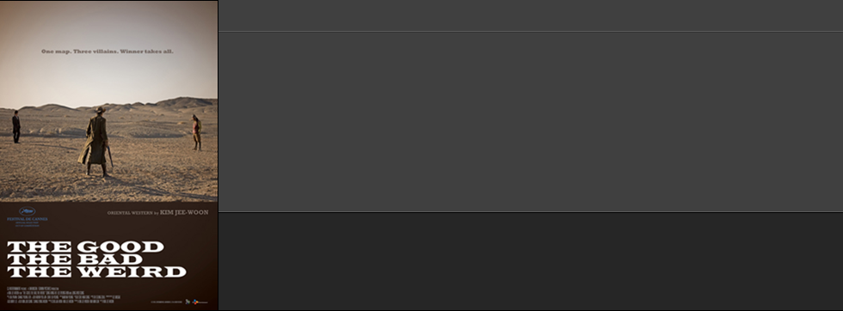

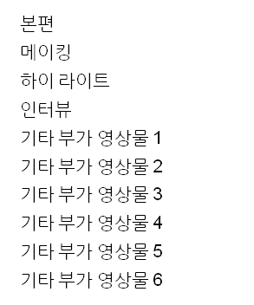
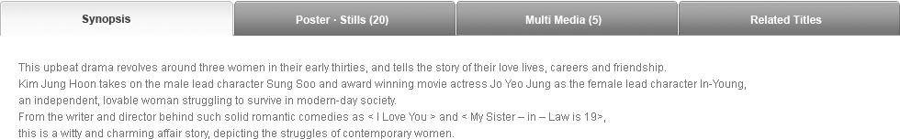

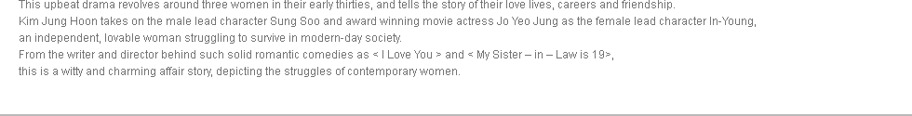
Access Request
| Send to E-mail
| Favorites
Brochure Download
권한신청
The Good, The Bad, The Weird
좋은 놈, 나쁜 놈, 이상한 놈 (부제: 석양의 무법자)
좋은 놈, 나쁜 놈, 이상한 놈
Oriental Western | 139 min | Release Date : 07. 17 . 2008
Production Country : Korea | Production Year : 2008
Director : KIM Jee-woon
Cast : SONG Kang-ho, LEE Byung-hun, JUNG Woo-sung
Language : Korean, English
2.35: 1 / Dolby Digital SRD Ex 6.1
Poster / Images (20)
Multi Media (5)
Trailer | Making
Trailer
Trailer
Making
요청하신 콘텐츠는 관지라의 승인 시점부터 2주간 권한이 주어지며, 기간 만료 후 이용을 원하시면 재요청하셔야 합니다.
취소
확인

Slide 16
메일 보내기
CJ B2B LIBRARY “좋은 놈, 나쁜 놈, 이상한 놈”
E-mail
해당 콘텐츠의 상세화면 링크를 입력하신 메일 주소로 보냅니다.
추가로 코멘트할 내용이 있으면 이곳에 입력해 주세요.
취소
확인

Slide 17
바이어 관리

Slide 18
바이어 관리 >
회원관리

Slide 19
CJ E&M Library 관리자
B2B메인 바로 가기
로그아웃
바이어 관리
콘텐츠 관리
사이트 관리
회원 관리 ▲
회원 리스트
아이디
전체보기
대기
▼
아이디,이름,국가
검색
미지정
새 그룹...
전체 (123,456) ㅣ 대기 (123,456) ㅣ 승인 (123,456) ㅣ 반려 (123,456) ㅣ 차단 (123,456)
승인
반려
차단
삭제
그룹이동 ▼
+ 회원추가
담당자 변경
반려
차단
□ | 아이디 | 이름 | 성 | 국가 | 회사명 | 가입일 ▼ | 상태
□ | 1120
□ | 19
□ | 18
□ | 17
□ | 16
□ | 15
□ | 14
□ | 13
□ | 12
□ | 11
□ | 10
□ | 9
□ | 8
□ | 7
□ | 6
□ | 5
□ | 4
□ | 3
□ | 2
□ | 1
FoxTVdigital@fox.com
abcdefg@cj.net
abcdefg@cj.net
abcdefg@cj.net
abcdefg@cj.net
abcdefg@cj.net
abcdefg@cj.net
abcdefg@cj.net
abcdefg@cj.net
abcdefg@cj.net
abcdefg@cj.net
abcdefg@cj.net
abcdefg@cj.net
abcdefg@cj.net
abcdefg@cj.net
abcdefg@cj.net
abcdefg@cj.net
abcdefg@cj.net
abcdefg@cj.net
abcdefg@cj.net
Alexandria
Tristan Padalecki
abcdefghijk
abcdefghijk
abcdefghijk
abcdefghijk
abcdefghijk
abcdefghijk
abcdefghijk
abcdefghijk
abcdefghijk
abcdefghijk
abcdefghijk
abcdefghijk
abcdefghijk
abcdefghijk
abcdefghijk
abcdefghijk
abcdefghijk
abcdefghijk
Jared
Jared
Jared
Jared
Jared
Jared
Jared
Jared
Jared
Jared
Jared
Jared
Jared
Jared
Jared
Jared
Jared
Jared
Jared
Jared
아랍에미리트
사우디아라비아
한국
미국
아시아
가나다라마바사
가나다라마바사
가나다라마바사
가나다라마바사
가나다라마바사
가나다라마바사
가나다라마바사
가나다라마바사
가나다라마바사
가나다라마바사
가나다라마바사
가나다라마바사
가나다라마바사
가나다라마바사
가나다라마바사
FOXFAST
가나다라마바사
가나다라마바사
가나다라마바사
가나다라마바사
가나다라마바사
가나다라마바사
가나다라마바사
가나다라마바사
가나다라마바사
가나다라마바사
가나다라마바사
가나다라마바사
가나다라마바사
가나다라마바사
가나다라마바사
가나다라마바사
가나다라마바사
가나다라마바사
가나다라마바사
11.10.24
10.11.11
yy.mm.dd
yy.mm.dd
yy.mm.dd
yy.mm.dd
yy.mm.dd
yy.mm.dd
yy.mm.dd
yy.mm.dd
yy.mm.dd
yy.mm.dd
yy.mm.dd
yy.mm.dd
yy.mm.dd
yy.mm.dd
yy.mm.dd
yy.mm.dd
yy.mm.dd
yy.mm.dd
대기
대기
대기
대기
대기
반려
반려
반려
반려
반려
그룹A
그룹A
그룹A
그룹A
그룹A
미지정
미지정
미지정
미지정
미지정
탈퇴
권한 요청 관리 ▲
방송 권한요청 관리
영화 권한요청 관리
권한 승인 관리 ▲
콘텐츠별 권한 승인 관리
회원별 권한 승인 관리
메일링 서비스 ▲
알림 메일
프로모션 메일
접근 로그보기 ▲
콘텐츠별 접근로그
회원별 접근로그
□
전체선택
승인
반려
차단
삭제
그룹이동 ▼
+ 회원추가
담당자 변경
Paginate
<< < 1 2 3 4 5 6 7 8 9 10 … 14 > >>
회원 아이디 클릭 시 새창 팝업

Slide 20
CJ E&M Library (로고)
B2B메인 바로 가기
로그아웃
바이어 관리
콘텐츠 관리
사이트 관리
회원 관리 ▲
회원 리스트
아이디
전체보기
대기
▼
아이디,이름,국가
검색
미지정
새 그룹...
전체 (123,456) ㅣ 대기 (123,456) ㅣ 승인 (123,456) ㅣ 반려 (123,456) ㅣ 차단 (123,456)
승인
반려
차단
삭제
그룹이동 ▼
+ 회원추가
담당자 변경
□ | 아이디 | 이름 | 성 | 국가 | 회사명 | 가입일 ▼ | 상태
반려
차단
□ | 1120
□ | 19
□ | 18
□ | 17
□ | 16
□ | 15
□ | 14
□ | 13
□ | 12
□ | 11
□ | 10
□ | 9
□ | 8
□ | 7
□ | 6
□ | 5
□ | 4
□ | 3
□ | 2
□ | 1
FoxTVdigital@fox.com
abcdefg@cj.net
abcdefg@cj.net
abcdefg@cj.net
abcdefg@cj.net
abcdefg@cj.net
abcdefg@cj.net
abcdefg@cj.net
abcdefg@cj.net
abcdefg@cj.net
abcdefg@cj.net
abcdefg@cj.net
abcdefg@cj.net
abcdefg@cj.net
abcdefg@cj.net
abcdefg@cj.net
abcdefg@cj.net
abcdefg@cj.net
abcdefg@cj.net
abcdefg@cj.net
담당자 변경
Alexandria
Tristan Padalecki
abcdefghijk
abcdefghijk
abcdefghijk
abcdefghijk
abcdefghijk
abcdefghijk
abcdefghijk
abcdefghijk
abcdefghijk
abcdefghijk
abcdefghijk
abcdefghijk
abcdefghijk
abcdefghijk
abcdefghijk
abcdefghijk
abcdefghijk
abcdefghijk
Jared
Jared
Jared
Jared
Jared
Jared
Jared
Jared
Jared
Jared
Jared
Jared
Jared
Jared
Jared
Jared
Jared
Jared
Jared
Jared
아랍에미리트
사우디아라비아
한국
미국
아시아
가나다라마바사
가나다라마바사
가나다라마바사
가나다라마바사
가나다라마바사
가나다라마바사
가나다라마바사
가나다라마바사
가나다라마바사
가나다라마바사
가나다라마바사
가나다라마바사
가나다라마바사
가나다라마바사
가나다라마바사
FOXFAST
가나다라마바사
가나다라마바사
가나다라마바사
가나다라마바사
가나다라마바사
가나다라마바사
가나다라마바사
가나다라마바사
가나다라마바사
가나다라마바사
가나다라마바사
가나다라마바사
가나다라마바사
가나다라마바사
가나다라마바사
가나다라마바사
가나다라마바사
가나다라마바사
가나다라마바사
11.10.24
10.11.11
yy.mm.dd
yy.mm.dd
yy.mm.dd
yy.mm.dd
yy.mm.dd
yy.mm.dd
yy.mm.dd
yy.mm.dd
yy.mm.dd
yy.mm.dd
yy.mm.dd
yy.mm.dd
yy.mm.dd
yy.mm.dd
yy.mm.dd
yy.mm.dd
yy.mm.dd
yy.mm.dd
대기
대기
대기
대기
대기
반려
반려
반려
반려
반려
그룹A
그룹A
그룹A
그룹A
그룹A
미지정
미지정
미지정
미지정
미지정
탈퇴
ID
이름
지역
부서
○
○
○
○
○
○
○
○
○
○
abcdefg@cj.net
abcdefg@cj.net
abcdefg@cj.net
abcdefg@cj.net
abcdefg@cj.net
abcdefg@cj.net
abcdefg@cj.net
abcdefg@cj.net
abcdefg@cj.net
abcdefg@cj.net
가나다
가나다
가나다
가나다
가나다
가나다
가나다
가나다
가나다
가나다
유럽, 미주
유럽, 미주
유럽, 미주
유럽, 미주
유럽, 미주
아시아
아시아
아시아
아시아
아시아
가나다라마바사아자차
가나다라마바사아자차
가나다라마바사아자차
가나다라마바사아자차
가나다라마바사아자차
가나다라마바사아자차
가나다라마바사아자차
가나다라마바사아자차
가나다라마바사아자차
가나다라마바사아자차
권한 요청 관리 ▲
방송 권한요청 관리
영화 권한요청 관리
권한 승인 관리 ▲
콘텐츠별 권한 승인 관리
회원별 권한 승인 관리
메일링 서비스 ▲
알림 메일
프로모션 메일
취소
확인
접근 로그보기 ▲
콘텐츠별 접근로그
회원별 접근로그
□
전체선택
승인
반려
차단
삭제
그룹이동 ▼
+ 회원추가
담당자 변경
Paginate
<< < 1 2 3 4 5 6 7 8 9 10 … 14 > >>
회원 아이디 클릭 시 새창 팝업

Slide 21
CJ E&M Library (로고)
B2B메인 바로 가기
로그아웃
바이어 관리
콘텐츠 관리
사이트 관리
회원 관리 ▲
회원 리스트
아이디
전체보기
대기
▼
아이디,이름,국가
검색
미지정
그룹 A
그룹 B
그룹 C
새 그룹...
전체 (123,456)
승인 ▼
반려
삭제
그룹이동 ▼
+ 회원추가
담당자 변경
승인 ▼
□ | 아이디 | 이름 | 성 | 국가 | 회사명 | 가입일 ▼ | 상태
◎
○
○
○
미지정
그룹 A
그룹 B
그룹 C
새 그룹…
□ | 1120
□ | 19
□ | 18
□ | 17
□ | 16
□ | 15
□ | 14
□ | 13
□ | 12
□ | 11
□ | 10
□ | 9
□ | 8
□ | 7
□ | 6
□ | 5
□ | 4
□ | 3
□ | 2
□ | 1
FoxTVdigital@fox.com
abcdefg@cj.net
abcdefg@cj.net
abcdefg@cj.net
abcdefg@cj.net
abcdefg@cj.net
abcdefg@cj.net
abcdefg@cj.net
abcdefg@cj.net
abcdefg@cj.net
abcdefg@cj.net
abcdefg@cj.net
abcdefg@cj.net
abcdefg@cj.net
abcdefg@cj.net
abcdefg@cj.net
abcdefg@cj.net
abcdefg@cj.net
abcdefg@cj.net
abcdefg@cj.net
Alexandria
Tristan Padalecki
abcdefghijk
abcdefghijk
abcdefghijk
abcdefghijk
abcdefghijk
abcdefghijk
abcdefghijk
abcdefghijk
abcdefghijk
abcdefghijk
abcdefghijk
abcdefghijk
abcdefghijk
abcdefghijk
abcdefghijk
abcdefghijk
abcdefghijk
abcdefghijk
Jared
Jared
Jared
Jared
Jared
Jared
Jared
Jared
Jared
Jared
Jared
Jared
Jared
Jared
Jared
Jared
Jared
Jared
Jared
Jared
아랍에미리트
사우디아라비아
한국
미국
아시아
가나다라마바사
가나다라마바사
가나다라마바사
가나다라마바사
가나다라마바사
가나다라마바사
가나다라마바사
가나다라마바사
가나다라마바사
가나다라마바사
가나다라마바사
가나다라마바사
가나다라마바사
가나다라마바사
가나다라마바사
FOXFAST
가나다라마바사
가나다라마바사
가나다라마바사
가나다라마바사
가나다라마바사
가나다라마바사
가나다라마바사
가나다라마바사
가나다라마바사
가나다라마바사
가나다라마바사
가나다라마바사
가나다라마바사
가나다라마바사
가나다라마바사
가나다라마바사
가나다라마바사
가나다라마바사
가나다라마바사
11.10.24
10.11.11
yy.mm.dd
yy.mm.dd
yy.mm.dd
yy.mm.dd
yy.mm.dd
yy.mm.dd
yy.mm.dd
yy.mm.dd
yy.mm.dd
yy.mm.dd
yy.mm.dd
yy.mm.dd
yy.mm.dd
yy.mm.dd
yy.mm.dd
yy.mm.dd
yy.mm.dd
yy.mm.dd
대기
대기
대기
대기
대기
대기
대기
대기
대기
대기
대기
대기
대기
대기
대기
대기
대기
대기
대기
대기
반려
차단
탈퇴
그룹 이동 ▼
권한 요청 관리 ▲
방송 권한요청 관리
영화 권한요청 관리
◎
○
○
○
미지정
그룹 A
그룹 B
그룹 C
새 그룹...
권한 승인 관리 ▲
콘텐츠별 권한 승인 관리
회원별 권한 승인 관리
메일링 서비스 ▲
알림 메일
프로모션 메일
접근 로그보기 ▲
콘텐츠별 접근로그
회원별 접근로그
□
전체선택
승인
반려
차단
삭제
그룹이동 ▼
+ 회원추가
담당자 변경
Paginate
<< < 1 2 3 4 5 6 7 8 9 10 … 14 > >>
새 그룹
X
새 그룹 이름을 입력하세요.
콘텐츠 접근 권한을 선택해 주세요.
콘텐츠 구분
권한
본편 영상 전체
본편영상 1, 2회
티져예고
본예고
메이킹
하이라이트
인터뷰
워터마크 스크리너
기타 부가영상물
□
■
■
■
□
■
□
□
□
취소
확인

Slide 22
CJ E&M Library (로고)
B2B메인 바로 가기
로그아웃
바이어 관리
콘텐츠 관리
사이트 관리
회원 관리 ▲
회원 리스트
아이디
전체보기
대기
▼
아이디,이름,국가
검색
미지정
그룹 A
그룹 B
그룹 C
새 그룹...
전체 (123,456)
차단
삭제
그룹이동 ▼
+ 회원추가
담당자 변경
그룹 이동 ▼
□ | 아이디 | 이름 | 성 | 국가 | 회사명 | 가입일 ▼ | 상태
○
◎
○
○
미지정
그룹 A
그룹 B
그룹 C
새 그룹...
그룹 이름/설정 변경
그룹 삭제
□ | 1120
□ | 19
□ | 18
□ | 17
□ | 16
□ | 15
□ | 14
□ | 13
□ | 12
□ | 11
□ | 10
□ | 9
□ | 8
□ | 7
□ | 6
□ | 5
□ | 4
□ | 3
□ | 2
□ | 1
FoxTVdigital@fox.com
abcdefg@cj.net
abcdefg@cj.net
abcdefg@cj.net
abcdefg@cj.net
abcdefg@cj.net
abcdefg@cj.net
abcdefg@cj.net
abcdefg@cj.net
abcdefg@cj.net
abcdefg@cj.net
abcdefg@cj.net
abcdefg@cj.net
abcdefg@cj.net
abcdefg@cj.net
abcdefg@cj.net
abcdefg@cj.net
abcdefg@cj.net
abcdefg@cj.net
abcdefg@cj.net
Alexandria
Tristan Padalecki
abcdefghijk
abcdefghijk
abcdefghijk
abcdefghijk
abcdefghijk
abcdefghijk
abcdefghijk
abcdefghijk
abcdefghijk
abcdefghijk
abcdefghijk
abcdefghijk
abcdefghijk
abcdefghijk
abcdefghijk
abcdefghijk
abcdefghijk
abcdefghijk
Jared
Jared
Jared
Jared
Jared
Jared
Jared
Jared
Jared
Jared
Jared
Jared
Jared
Jared
Jared
Jared
Jared
Jared
Jared
Jared
아랍에미리트
사우디아라비아
한국
미국
아시아
가나다라마바사
가나다라마바사
가나다라마바사
가나다라마바사
가나다라마바사
가나다라마바사
가나다라마바사
가나다라마바사
가나다라마바사
가나다라마바사
가나다라마바사
가나다라마바사
가나다라마바사
가나다라마바사
가나다라마바사
FOXFAST
가나다라마바사
가나다라마바사
가나다라마바사
가나다라마바사
가나다라마바사
가나다라마바사
가나다라마바사
가나다라마바사
가나다라마바사
가나다라마바사
가나다라마바사
가나다라마바사
가나다라마바사
가나다라마바사
가나다라마바사
가나다라마바사
가나다라마바사
가나다라마바사
가나다라마바사
11.10.24
10.11.11
yy.mm.dd
yy.mm.dd
yy.mm.dd
yy.mm.dd
yy.mm.dd
yy.mm.dd
yy.mm.dd
yy.mm.dd
yy.mm.dd
yy.mm.dd
yy.mm.dd
yy.mm.dd
yy.mm.dd
yy.mm.dd
yy.mm.dd
yy.mm.dd
yy.mm.dd
yy.mm.dd
그룹 A
그룹 A
그룹 A
그룹 A
그룹 A
그룹 A
그룹 A
그룹 A
그룹 A
그룹 A
그룹 A
그룹 A
그룹 A
그룹 A
그룹 A
그룹 A
그룹 A
그룹 A
그룹 A
그룹 A
반려
차단
탈퇴
권한 요청 관리 ▲
방송 권한요청 관리
영화 권한요청 관리
권한 승인 관리 ▲
콘텐츠별 권한 승인 관리
회원별 권한 승인 관리
메일링 서비스 ▲
알림 메일
프로모션 메일
접근 로그보기 ▲
콘텐츠별 접근로그
회원별 접근로그
□
전체선택
승인
반려
차단
삭제
그룹이동 ▼
+ 회원추가
담당자 변경
Paginate
<< < 1 2 3 4 5 6 7 8 9 10 … 14 > >>
그룹 이름/설정 변경
X
그룹 삭제
X
새 그룹 이름을 입력하세요.
‘그룹 A’ 그룹을 삭제하시겠습니까? 포함된 회원은 ‘그룹 미지정’ 으로 이동합니다.
그룹 A
콘텐츠 접근 권한을 선택해 주세요.
취소
확인
콘텐츠 구분
권한
본편 영상 전체
본편영상 1, 2회
티져예고
본예고
메이킹
하이라이트
인터뷰
워터마크 스크리너
기타 부가영상물
□
■
■
■
□
■
□
□
□
취소
확인

Slide 23
CJ E&M Library 관리자
B2B메인 바로 가기
로그아웃
바이어 관리
콘텐츠 관리
사이트 관리
회원 관리 ▲
회원 리스트
아이디
전체보기
대기
▼
아이디,이름,국가
검색
미지정
그룹 A
그룹 B
그룹 C
새 그룹...
전체 (123,456)
승인
차단
삭제
+ 회원추가
담당자 변경
□ | 아이디 | 이름 | 성 | 국가 | 회사명 | 가입일 ▼ | 상태
□ | 1120
□ | 19
□ | 18
□ | 17
□ | 16
□ | 15
□ | 14
□ | 13
□ | 12
□ | 11
□ | 10
□ | 9
□ | 8
□ | 7
□ | 6
□ | 5
□ | 4
□ | 3
□ | 2
□ | 1
FoxTVdigital@fox.com
abcdefg@cj.net
abcdefg@cj.net
abcdefg@cj.net
abcdefg@cj.net
abcdefg@cj.net
abcdefg@cj.net
abcdefg@cj.net
abcdefg@cj.net
abcdefg@cj.net
abcdefg@cj.net
abcdefg@cj.net
abcdefg@cj.net
abcdefg@cj.net
abcdefg@cj.net
abcdefg@cj.net
abcdefg@cj.net
abcdefg@cj.net
abcdefg@cj.net
abcdefg@cj.net
Alexandria
Tristan Padalecki
abcdefghijk
abcdefghijk
abcdefghijk
abcdefghijk
abcdefghijk
abcdefghijk
abcdefghijk
abcdefghijk
abcdefghijk
abcdefghijk
abcdefghijk
abcdefghijk
abcdefghijk
abcdefghijk
abcdefghijk
abcdefghijk
abcdefghijk
abcdefghijk
Jared
Jared
Jared
Jared
Jared
Jared
Jared
Jared
Jared
Jared
Jared
Jared
Jared
Jared
Jared
Jared
Jared
Jared
Jared
Jared
아랍에미리트
사우디아라비아
한국
미국
아시아
가나다라마바사
가나다라마바사
가나다라마바사
가나다라마바사
가나다라마바사
가나다라마바사
가나다라마바사
가나다라마바사
가나다라마바사
가나다라마바사
가나다라마바사
가나다라마바사
가나다라마바사
가나다라마바사
가나다라마바사
FOXFAST
가나다라마바사
가나다라마바사
가나다라마바사
가나다라마바사
가나다라마바사
가나다라마바사
가나다라마바사
가나다라마바사
가나다라마바사
가나다라마바사
가나다라마바사
가나다라마바사
가나다라마바사
가나다라마바사
가나다라마바사
가나다라마바사
가나다라마바사
가나다라마바사
가나다라마바사
11.10.24
10.11.11
yy.mm.dd
yy.mm.dd
yy.mm.dd
yy.mm.dd
yy.mm.dd
yy.mm.dd
yy.mm.dd
yy.mm.dd
yy.mm.dd
yy.mm.dd
yy.mm.dd
yy.mm.dd
yy.mm.dd
yy.mm.dd
yy.mm.dd
yy.mm.dd
yy.mm.dd
yy.mm.dd
반려
반려
반려
반려
반려
반려
반려
반려
반려
반려
반려
반려
반려
반려
반려
반려
반려
반려
반려
반려
반려
차단
탈퇴
권한 요청 관리 ▲
방송 권한요청 관리
영화 권한요청 관리
권한 승인 관리 ▲
콘텐츠별 권한 승인 관리
회원별 권한 승인 관리
메일링 서비스 ▲
알림 메일
프로모션 메일
접근 로그보기 ▲
콘텐츠별 접근로그
회원별 접근로그
□
전체선택
승인
차단
삭제
+ 회원추가
담당자 변경
Paginate
<< < 1 2 3 4 5 6 7 8 9 10 … 14 > >>

Slide 24
CJ E&M Library 관리자
B2B메인 바로 가기
로그아웃
바이어 관리
콘텐츠 관리
사이트 관리
회원 관리 ▲
회원 리스트
아이디
전체보기
대기
▼
아이디,이름,국가
검색
미지정
그룹 A
그룹 B
그룹 C
새 그룹...
전체 (123,456)
승인
삭제
+ 회원추가
담당자 변경
□ | 아이디 | 이름 | 성 | 국가 | 회사명 | 가입일 ▼ | 상태
□ | 1120
□ | 19
□ | 18
□ | 17
□ | 16
□ | 15
□ | 14
□ | 13
□ | 12
□ | 11
□ | 10
□ | 9
□ | 8
□ | 7
□ | 6
□ | 5
□ | 4
□ | 3
□ | 2
□ | 1
FoxTVdigital@fox.com
abcdefg@cj.net
abcdefg@cj.net
abcdefg@cj.net
abcdefg@cj.net
abcdefg@cj.net
abcdefg@cj.net
abcdefg@cj.net
abcdefg@cj.net
abcdefg@cj.net
abcdefg@cj.net
abcdefg@cj.net
abcdefg@cj.net
abcdefg@cj.net
abcdefg@cj.net
abcdefg@cj.net
abcdefg@cj.net
abcdefg@cj.net
abcdefg@cj.net
abcdefg@cj.net
Alexandria
Tristan Padalecki
abcdefghijk
abcdefghijk
abcdefghijk
abcdefghijk
abcdefghijk
abcdefghijk
abcdefghijk
abcdefghijk
abcdefghijk
abcdefghijk
abcdefghijk
abcdefghijk
abcdefghijk
abcdefghijk
abcdefghijk
abcdefghijk
abcdefghijk
abcdefghijk
Jared
Jared
Jared
Jared
Jared
Jared
Jared
Jared
Jared
Jared
Jared
Jared
Jared
Jared
Jared
Jared
Jared
Jared
Jared
Jared
아랍에미리트
사우디아라비아
한국
미국
아시아
가나다라마바사
가나다라마바사
가나다라마바사
가나다라마바사
가나다라마바사
가나다라마바사
가나다라마바사
가나다라마바사
가나다라마바사
가나다라마바사
가나다라마바사
가나다라마바사
가나다라마바사
가나다라마바사
가나다라마바사
FOXFAST
가나다라마바사
가나다라마바사
가나다라마바사
가나다라마바사
가나다라마바사
가나다라마바사
가나다라마바사
가나다라마바사
가나다라마바사
가나다라마바사
가나다라마바사
가나다라마바사
가나다라마바사
가나다라마바사
가나다라마바사
가나다라마바사
가나다라마바사
가나다라마바사
가나다라마바사
11.10.24
10.11.11
yy.mm.dd
yy.mm.dd
yy.mm.dd
yy.mm.dd
yy.mm.dd
yy.mm.dd
yy.mm.dd
yy.mm.dd
yy.mm.dd
yy.mm.dd
yy.mm.dd
yy.mm.dd
yy.mm.dd
yy.mm.dd
yy.mm.dd
yy.mm.dd
yy.mm.dd
yy.mm.dd
차단
차단
차단
차단
차단
차단
차단
차단
차단
차단
차단
차단
차단
차단
차단
차단
차단
차단
차단
차단
반려
차단
탈퇴
권한 요청 관리 ▲
방송 권한요청 관리
영화 권한요청 관리
권한 승인 관리 ▲
콘텐츠별 권한 승인 관리
회원별 권한 승인 관리
메일링 서비스 ▲
알림 메일
프로모션 메일
접근 로그보기 ▲
콘텐츠별 접근로그
회원별 접근로그
□
전체선택
승인
삭제
+ 회원추가
담당자 변경
Paginate
<< < 1 2 3 4 5 6 7 8 9 10 … 14 > >>
회원 아이디 클릭 시 새창 팝업

Slide 25
CJ E&M Library 관리자
B2B메인 바로 가기
로그아웃
바이어 관리
콘텐츠 관리
사이트 관리
회원 관리 ▲
회원 리스트
아이디
전체보기
대기
▼
아이디,이름,국가
검색
미지정
그룹 A
그룹 B
그룹 C
새 그룹...
전체 (123,456) ㅣ 탈퇴신청 (123,456) ㅣ 탈퇴 (123,456)
탈퇴승인
□ | 아이디 | 이름 | 성 | 국가 | 회사명 | 가입일 ▼ | 상태
□ | 1120
□ | 19
□ | 18
□ | 17
□ | 16
□ | 15
□ | 14
□ | 13
□ | 12
□ | 11
□ | 10
□ | 9
□ | 8
□ | 7
□ | 6
□ | 5
□ | 4
□ | 3
□ | 2
□ | 1
FoxTVdigital@fox.com
abcdefg@cj.net
abcdefg@cj.net
abcdefg@cj.net
abcdefg@cj.net
abcdefg@cj.net
abcdefg@cj.net
abcdefg@cj.net
abcdefg@cj.net
abcdefg@cj.net
abcdefg@cj.net
abcdefg@cj.net
abcdefg@cj.net
abcdefg@cj.net
abcdefg@cj.net
abcdefg@cj.net
abcdefg@cj.net
abcdefg@cj.net
abcdefg@cj.net
abcdefg@cj.net
Alexandria
Tristan Padalecki
abcdefghijk
abcdefghijk
abcdefghijk
abcdefghijk
abcdefghijk
abcdefghijk
abcdefghijk
abcdefghijk
abcdefghijk
abcdefghijk
abcdefghijk
abcdefghijk
abcdefghijk
abcdefghijk
abcdefghijk
abcdefghijk
abcdefghijk
abcdefghijk
Jared
Jared
Jared
Jared
Jared
Jared
Jared
Jared
Jared
Jared
Jared
Jared
Jared
Jared
Jared
Jared
Jared
Jared
Jared
Jared
아랍에미리트
사우디아라비아
한국
미국
아시아
가나다라마바사
가나다라마바사
가나다라마바사
가나다라마바사
가나다라마바사
가나다라마바사
가나다라마바사
가나다라마바사
가나다라마바사
가나다라마바사
가나다라마바사
가나다라마바사
가나다라마바사
가나다라마바사
가나다라마바사
FOXFAST
가나다라마바사
가나다라마바사
가나다라마바사
가나다라마바사
가나다라마바사
가나다라마바사
가나다라마바사
가나다라마바사
가나다라마바사
가나다라마바사
가나다라마바사
가나다라마바사
가나다라마바사
가나다라마바사
가나다라마바사
가나다라마바사
가나다라마바사
가나다라마바사
가나다라마바사
11.10.24
10.11.11
yy.mm.dd
yy.mm.dd
yy.mm.dd
yy.mm.dd
yy.mm.dd
yy.mm.dd
yy.mm.dd
yy.mm.dd
yy.mm.dd
yy.mm.dd
yy.mm.dd
yy.mm.dd
yy.mm.dd
yy.mm.dd
yy.mm.dd
yy.mm.dd
yy.mm.dd
yy.mm.dd
탈퇴신청
탈퇴신청
탈퇴신청
탈퇴신청
탈퇴신청
탈퇴신청
탈퇴신청
탈퇴신청
탈퇴신청
탈퇴신청
탈퇴
탈퇴
탈퇴
탈퇴
탈퇴
탈퇴
탈퇴
탈퇴
탈퇴
탈퇴
반려
차단
탈퇴
권한 요청 관리 ▲
방송 권한요청 관리
영화 권한요청 관리
권한 승인 관리 ▲
콘텐츠별 권한 승인 관리
회원별 권한 승인 관리
메일링 서비스 ▲
알림 메일
프로모션 메일
접근 로그보기 ▲
콘텐츠별 접근로그
회원별 접근로그
□
전체선택
탈퇴승인
Paginate
<< < 1 2 3 4 5 6 7 8 9 10 … 14 > >>
회원 아이디 클릭 시 새창 팝업

Slide 26
CJ E&M Library 관리자
B2B메인 바로 가기
로그아웃
바이어 관리
콘텐츠 관리
사이트 관리
회원 관리 ▲
회원 리스트
아이디
전체보기
대기
▼
아이디,이름,국가
검색
미지정
그룹 A
그룹 B
그룹 C
새 그룹...
전체 (123,456) ㅣ 탈퇴신청 (123,456) ㅣ 탈퇴 (123,456)
탈퇴승인
□ | 아이디 | 이름 | 성 | 국가 | 회사명 | 가입일 ▼ | 상태
□ | 1120
□ | 19
□ | 18
□ | 17
□ | 16
□ | 15
□ | 14
□ | 13
□ | 12
□ | 11
□ | 10
□ | 9
□ | 8
□ | 7
□ | 6
□ | 5
□ | 4
□ | 3
□ | 2
□ | 1
FoxTVdigital@fox.com
abcdefg@cj.net
abcdefg@cj.net
abcdefg@cj.net
abcdefg@cj.net
abcdefg@cj.net
abcdefg@cj.net
abcdefg@cj.net
abcdefg@cj.net
abcdefg@cj.net
abcdefg@cj.net
abcdefg@cj.net
abcdefg@cj.net
abcdefg@cj.net
abcdefg@cj.net
abcdefg@cj.net
abcdefg@cj.net
abcdefg@cj.net
abcdefg@cj.net
abcdefg@cj.net
Alexandria
Tristan Padalecki
abcdefghijk
abcdefghijk
abcdefghijk
abcdefghijk
abcdefghijk
abcdefghijk
abcdefghijk
abcdefghijk
abcdefghijk
abcdefghijk
abcdefghijk
abcdefghijk
abcdefghijk
abcdefghijk
abcdefghijk
abcdefghijk
abcdefghijk
abcdefghijk
Jared
Jared
Jared
Jared
Jared
Jared
Jared
Jared
Jared
Jared
Jared
Jared
Jared
Jared
Jared
Jared
Jared
Jared
Jared
Jared
아랍에미리트
사우디아라비아
한국
미국
아시아
가나다라마바사
가나다라마바사
가나다라마바사
가나다라마바사
가나다라마바사
가나다라마바사
가나다라마바사
가나다라마바사
가나다라마바사
가나다라마바사
가나다라마바사
가나다라마바사
가나다라마바사
가나다라마바사
가나다라마바사
FOXFAST
가나다라마바사
가나다라마바사
가나다라마바사
가나다라마바사
가나다라마바사
가나다라마바사
가나다라마바사
가나다라마바사
가나다라마바사
가나다라마바사
가나다라마바사
가나다라마바사
가나다라마바사
가나다라마바사
가나다라마바사
가나다라마바사
가나다라마바사
가나다라마바사
가나다라마바사
11.10.24
10.11.11
yy.mm.dd
yy.mm.dd
yy.mm.dd
yy.mm.dd
yy.mm.dd
yy.mm.dd
yy.mm.dd
yy.mm.dd
yy.mm.dd
yy.mm.dd
yy.mm.dd
yy.mm.dd
yy.mm.dd
yy.mm.dd
yy.mm.dd
yy.mm.dd
yy.mm.dd
yy.mm.dd
탈퇴신청
탈퇴신청
탈퇴신청
탈퇴신청
탈퇴신청
탈퇴신청
탈퇴신청
탈퇴신청
탈퇴신청
탈퇴신청
탈퇴
탈퇴
탈퇴
탈퇴
탈퇴
탈퇴
탈퇴
탈퇴
탈퇴
탈퇴
회원정보
Paginate
반려
차단
<< < 1 2 3 4 5 6 7 8 9 10 … 14 > >>
탈퇴
아이디
abcdefgh@abc.com
권한승인 내역
탈퇴신청내용
스크롤 영역
이름
은정
권한 요청 관리 ▲
방송 권한요청 관리
영화 권한요청 관리
성
윤
연락처
820123456789
권한 승인 관리 ▲
콘텐츠별 권한 승인 관리
회원별 권한 승인 관리
국가
대한민국
회사명
CJ
권한승인 내역
13건
메일링 서비스 ▲
알림 메일
프로모션 메일
접근 로그보기 ▲
콘텐츠별 접근로그
회원별 접근로그
탈퇴
□
전체선택
탈퇴승인
회원 아이디 클릭 시 새창 팝업

Slide 27
관리자 화면

Slide 28
콘텐츠 관리 >
방송 리스트

Slide 29
CJ E&M Library (로고)
B2B메인 바로 가기
로그아웃
바이어 관리
콘텐츠 관리
사이트 관리
방송 콘텐츠 관리
방송 B2B 콘텐츠리스트
프로그램
방송 B2B 콘텐츠리스트
프로그램정보 입력
회차정보 입력
DCW콘텐츠 가져오기
▼
검색
전체 (123,456) ㅣ 공개 (123,456) ㅣ 비공개 (123,456)
공개
비공개
신규등록
전체
ㄱ
ㄴ
ㄷ
ㄹ
ㅁ
ㅂ
ㅅ
ㅇ
ㅈ
ㅊ
ㅋ
ㅌ
ㅍ
ㅎ
etc
□ | 프로그램 명 ▼ | 현황 | 시즌 | 제작년도 | 등록자 | 입력상태 | 상태
입력
▼
노출
□ | 1120
□ | 19
□ | 18
□ | 17
□ | 16
□ | 15
□ | 14
□ | 13
□ | 12
□ | 11
□ | 10
□ | 9
□ | 8
□ | 7
□ | 6
□ | 5
□ | 4
□ | 3
□ | 2
□ | 1
▼
가나다라마바사아자차카타파하..
가나다라마바사
가나다라마바사
가나다라마바사
가나다라마바사
가나다라마바사
가나다라마바사
가나다라마바사
가나다라마바사
가나다라마바사
가나다라마바사
가나다라마바사
가나다라마바사
가나다라마바사
가나다라마바사
가나다라마바사
가나다라마바사
가나다라마바사
가나다라마바사
가나다라마바사
1
2
1
2
3
4
5
6
1
2
3
4
2
3
4
5
6
2011
2011
2011
2011
2011
2011
2011
2011
2011
2011
2011
2011
2011
2011
2011
2011
2011
yyyy
yyyy
yyyy
등록자
등록자
등록자
등록자
등록자
등록자
등록자
등록자
등록자
등록자
등록자
등록자
등록자
등록자
등록자
등록자
등록자
등록자
등록자
등록자
완료
완료
완료
완료
완료
완료
완료
완료
완료
완료
완료
완료
미입력
미입력
미입력
입력중
입력중
입력중
입력중
입력중
공개
공개
공개
공개
공개
공개
공개
공개
공개
공개
공개
공개
공개
공개
공개
비공개
비공개
비공개
비공개
비공개
영화 콘텐츠 관리
NEW
END
?
영화 B2B 콘텐츠리스트
영화정보 입력
DCW 콘텐츠 가져오기
?
?
?
?
?
?
?
?
?
?
?
?
?
?
?
?
?
?
?
□
전체선택
공개
비공개
신규등록
Paginate

Slide 30
CJ E&M Library (로고)
B2B메인 바로 가기
로그아웃
바이어 관리
콘텐츠 관리
사이트 관리
방송 콘텐츠 관리
방송 B2B 콘텐츠리스트
검색
방송 B2B 콘텐츠리스트
프로그램정보 입력
회차정보 입력
DCW콘텐츠 가져오기
전체 (123,456) ㅣ 공개 (123,456) ㅣ 비공개 (123,456)
공개
비공개
신규등록
전체
ㄱ
ㄴ
ㄷ
ㄹ
ㅁ
ㅂ
ㅅ
ㅇ
ㅈ
ㅊ
ㅋ
ㅌ
ㅍ
ㅎ
etc
□ | 프로그램 명 ▼ | 현황 | 시즌 | 제작년도 | 등록자 | 입력상태 | 상태
입력
▼
노출
□ | 1120
□ | 19
□ | 18
□ | 17
□ | 16
□ | 15
□ | 14
□ | 13
□ | 12
□ | 11
□ | 10
□ | 9
□ | 8
□ | 7
□ | 6
□ | 5
□ | 4
□ | 3
□ | 2
□ | 1
▼
영화 콘텐츠 관리
가나다라마바사아자차카타파하..
가나다라마바사
가나다라마바사
가나다라마바사
가나다라마바사
가나다라마바사
가나다라마바사
가나다라마바사
가나다라마바사
가나다라마바사
가나다라마바사
가나다라마바사
가나다라마바사
가나다라마바사
가나다라마바사
가나다라마바사
가나다라마바사
가나다라마바사
가나다라마바사
가나다라마바사
?
1
2
1
2
3
4
5
6
1
2
3
4
2
3
4
5
6
2011
2011
2011
2011
2011
2011
2011
2011
2011
2011
2011
2011
2011
2011
2011
2011
2011
yyyy
yyyy
yyyy
등록자이름
등록자이름
등록자이름
등록자이름
등록자이름
등록자이름
등록자이름
등록자이름
등록자이름
등록자이름
등록자이름
등록자이름
등록자이름
등록자이름
등록자이름
등록자이름
등록자이름
등록자이름
등록자이름
등록자이름
완료
완료
완료
완료
완료
완료
완료
완료
완료
완료
완료
완료
미입력
미입력
미입력
입력중
입력중
입력중
입력중
입력중
공개
공개
공개
공개
공개
공개
공개
공개
공개
공개
공개
공개
공개
공개
공개
비공개
비공개
비공개
비공개
비공개
콘텐츠 업로드 현황
영화 B2B 콘텐츠리스트
영화정보 입력
DCW 콘텐츠 가져오기
본편영상 전체 | 24
본편영상 1, 2회 | 2
티져예고 | 1
본예고 | 1
메이킹 | 1
하이라이트 | 1
인터뷰 | 0
기타 부가 영상물 | 0
워터마크 스크리너 | 0
포스터 | 1
스틸컷 | 40
브로셔 | 1
?
?
?
?
?
?
?
?
?
?
?
?
?
?
?
?
?
?
?
□
전체선택
공개
비공개
신규등록
Paginate
<< < 1 2 3 4 5 6 7 8 9 10 … 14 > >>

Slide 31
CJ E&M Library (로고)
B2B메인 바로 가기
로그아웃
바이어 관리
콘텐츠 관리
사이트 관리
방송 콘텐츠 관리
영화 B2B 콘텐츠리스트
검색
방송 B2B 콘텐츠리스트
프로그램정보 입력
회차정보 입력
DCW콘텐츠 가져오기
전체 (123,456) ㅣ 공개 (123,456) ㅣ 비공개 (123,456)
공개
비공개
개봉예정
상영작
상영종료
신규등록
전체
ㄱ
ㄴ
ㄷ
ㄹ
ㅁ
ㅂ
ㅅ
ㅇ
ㅈ
ㅊ
ㅋ
ㅌ
ㅍ
ㅎ
etc
□ | 영화 제목 ▼ | 장르 제작년도 | 현황 | 등록자 |  | 등록일 ▼ | 분류
입력
▼
노출
▼
메뉴
□ | 1120
□ | 19
□ | 18
□ | 17
□ | 16
□ | 15
□ | 14
□ | 13
□ | 12
□ | 11
□ | 10
□ | 9
□ | 8
□ | 7
□ | 6
□ | 5
□ | 4
□ | 3
□ | 2
□ | 1
▼
영화 콘텐츠 관리
좋은 놈, 나쁜 놈, 이상한 놈
아내가 거짓말을 했다
여고괴담, 세번째 이야기 - 여우괴담
맥주가 애인보다 좋은 일곱 가지 이유
가나다라마바사아자차카타파하
가나다라마바사아자차카타파하
가나다라마바사아자차카타파하
가나다라마바사아자차카타파하
가나다라마바사아자차카타파하
가나다라마바사아자차카타파하
가나다라마바사아자차카타파하
가나다라마바사아자차카타파하
가나다라마바사아자차카타파하
가나다라마바사아자차카타파하
가나다라마바사아자차카타파하
가나다라마바사아자차카타파하
가나다라마바사아자차카타파하
가나다라마바사아자차카타파하
가나다라마바사아자차카타파하
가나다라마바사아자차카타파하
Action, Dra..
Oriental West..
Horror
Adventure
Action, Dra..
Oriental West..
Action, Dra..
Oriental West..
Action, Dra..
Oriental West..
Action, Dra..
Oriental West..
Action, Dra..
Oriental West..
Action, Dra..
Oriental West..
Action, Dra..
Oriental West..
Action, Dra..
Oriental West..
2011
2011
2011
2011
2011
2011
2011
2011
2011
2011
2011
2011
2011
2011
2011
2011
2011
yyyy
yyyy
yyyy
?
등록자명
등록자명
등록자명
등록자명
등록자명
등록자명
등록자명
등록자명
등록자명
등록자명
등록자명
등록자명
등록자명
등록자명
등록자명
등록자명
등록자명
등록자명
등록자명
등록자명
완료
완료
완료
완료
완료
완료
완료
완료
완료
완료
완료
완료
미입력
미입력
미입력
입력중
입력중
입력중
입력중
입력중
공개
공개
공개
공개
공개
공개
공개
공개
공개
공개
공개
공개
공개
공개
공개
비공개
비공개
비공개
비공개
비공개
11.10.24
10.11.11
yy.mm.dd
yy.mm.dd
yy.mm.dd
yy.mm.dd
yy.mm.dd
yy.mm.dd
yy.mm.dd
yy.mm.dd
yy.mm.dd
yy.mm.dd
yy.mm.dd
yy.mm.dd
yy.mm.dd
yy.mm.dd
yy.mm.dd
yy.mm.dd
yy.mm.dd
yy.mm.dd
개봉예정
개봉예정
개봉예정
개봉예정
개봉예정
개봉예정
상영작
상영작
상영작
상영작
상영작
상영작
상영작
상영작
상영종료
상영종료
상영종료
상영종료
상영종료
상영종료
영화 B2B 콘텐츠리스트
영화정보 입력
DCW 콘텐츠 가져오기
콘텐츠 업로드 현황
?
?
?
?
?
?
?
?
?
?
?
?
?
?
?
?
?
?
?
□
전체선택
공개
비공개
개봉예정
상영작
상영종료
신규등록
Paginate
<< < 1 2 3 4 5 6 7 8 9 10 … 14 > >>

Slide 32
사이트 관리 >
관리자 관리

Slide 33
CJ E&M Library (로고)
B2B메인 바로 가기
로그아웃
바이어 관리
콘텐츠 관리
사이트 관리
관리자 관리
관리자 리스트
관리자 리스트
관리자명
검색
게시물 관리
공지사항 관리
이용 가이드 관리
전체 (123,456) ㅣ 마스터 (123,456) ㅣ 관리자 (123,456)
X 삭제
+ 관리자 등록
□ | 구분 | 관리자명 | 업무 부서명 | 담당지역 | 아이디 | 등록일 | 권한
구분 전체
▼
콘텐츠 권한 정책 관리
방송 권한 정책 관리
영화 권한 정책 관리
□ | 1120
□ | 19
□ | 18
□ | 17
□ | 16
□ | 15
□ | 14
□ | 13
□ | 12
□ | 11
□ | 10
□ | 9
□ | 8
□ | 7
□ | 6
□ | 5
□ | 4
□ | 3
□ | 2
□ | 1
[방송] | 신지혜 | 콘텐츠 전략국 |  | reeseshin@cj.net | 11.10.24 | 마스터
[방송] | 강동한 | 콘텐츠 전략국 | 동남아시아, 유럽 | donkang@cj.net | 10.11.11 | 마스터
[방송] | 민다현 | 콘텐츠 전략국 | 중국, 미국 | diane@cj.net | yy.mm.dd | 마스터
[방송] | 어일경 | 콘텐츠 전략국 | 일본 | alexoe@cj.net | yy.mm.dd | 마스터
[영화] | 조창범 | 마케팅 | 유럽, 미주 | bryanjo@cj.net | yy.mm.dd | 마스터
[영화] | 이현주 | 마케팅 | 아시아 | lhj0524@cj.net | yy.mm.dd | 마스터
[영화] | 김현우 | 해외 영업전략 |  | justinkim@cj.net | yy.mm.dd | 마스터
[영화] | 김희전 | 세일즈 | 유럽, 미주 | heejeon@cj.net | yy.mm.dd | 마스터
[영화] | 정고은 | 세일즈 | 유럽, 미주 | joung-gon@cj.net | yy.mm.dd | 마스터
[영화] | 관리자명 | 업무 부서명 | 유럽, 미주 | abcdefg@cj.net | yy.mm.dd | 마스터
[영화] | 관리자명 | 업무 부서명 | 유럽, 미주 | abcdefg@cj.net | yy.mm.dd | 마스터
[영화] | 관리자명 | 업무 부서명 | 유럽, 미주 | abcdefg@cj.net | yy.mm.dd | 마스터
[영화] | 관리자명 | 업무 부서명 | 유럽, 미주 | abcdefg@cj.net | yy.mm.dd | 마스터
[영화] | 관리자명 | 업무 부서명 | 유럽, 미주 | abcdefg@cj.net | yy.mm.dd | 관리자
[영화] | 관리자명 | 업무 부서명 | 유럽, 미주 | abcdefg@cj.net | yy.mm.dd | 관리자
[영화] | 관리자명 | 업무 부서명 | 유럽, 미주 | abcdefg@cj.net | yy.mm.dd | 관리자
[영화] | 관리자명 | 업무 부서명 | 아시아 | abcdefg@cj.net | yy.mm.dd | 관리자
[영화] | 관리자명 | 업무 부서명 | 아시아 | abcdefg@cj.net | yy.mm.dd | 관리자
[영화] | 관리자명 | 업무 부서명 | 아시아 | abcdefg@cj.net | yy.mm.dd | 관리자
[영화] | 관리자명 | 업무 부서명 | 아시아 | abcdefg@cj.net | yy.mm.dd | 관리자
메인화면 관리
방송 메인화면
방송 메인팝업
영화 메인화면
영화 메인 팝업
장르 관리
방송 장르 구분
영화 장르 구분
담당 지역 그룹관리
방송 담당지역 그룹관리
영화 담당지역 그룹관리
□
전체선택
X 삭제
+ 관리자 등록
Paginate
<< < 1 2 3 4 5 6 7 8 9 10 … 14 > >>

Slide 34
CJ E&M Library (로고)
B2B메인 바로 가기
로그아웃
바이어 관리
콘텐츠 관리
사이트 관리
관리자 관리
관리자 리스트
관리자 리스트
관리자명
검색
게시물 관리
공지사항 관리
이용 가이드 관리
전체 (123,456) ㅣ 마스터 (123,456) ㅣ 관리자 (123,456)
X 삭제
+ 관리자 등록
관리자 등록
□ | 구분 | 관리자명 | 업무 부서명 | 담당지역 | 아이디 | 등록일 | 권한
구분 전체
▼
□ | 1120
□ | 19
□ | 18
□ | 17
□ | 16
□ | 15
□ | 14
□ | 13
□ | 12
□ | 11
□ | 10
□ | 9
□ | 8
□ | 7
□ | 6
□ | 5
□ | 4
□ | 3
□ | 2
□ | 1
[방송] | 신지혜 | 콘텐츠 전략국 |  | reeseshin@cj.net | 11.10.24 | 마스터
[방송] | 강동한 | 콘텐츠 전략국 | 동남아시아, 유럽 | donkang@cj.net | 10.11.11 | 마스터
[방송] | 민다현 | 콘텐츠 전략국 | 중국, 미국 | diane@cj.net | yy.mm.dd | 마스터
[방송] | 어일경 | 콘텐츠 전략국 | 일본 | alexoe@cj.net | yy.mm.dd | 마스터
[영화] | 조창범 | 마케팅 | 유럽, 미주 | bryanjo@cj.net | yy.mm.dd | 마스터
[영화] | 이현주 | 마케팅 | 아시아 | lhj0524@cj.net | yy.mm.dd | 마스터
[영화] | 김현우 | 해외 영업전략 |  | justinkim@cj.net | yy.mm.dd | 마스터
[영화] | 김희전 | 세일즈 | 유럽, 미주 | heejeon@cj.net | yy.mm.dd | 마스터
[영화] | 정고은 | 세일즈 | 유럽, 미주 | joung-gon@cj.net | yy.mm.dd | 마스터
[영화] | 관리자명 | 업무 부서명 | 유럽, 미주 | abcdefg@cj.net | yy.mm.dd | 마스터
[영화] | 관리자명 | 업무 부서명 | 유럽, 미주 | abcdefg@cj.net | yy.mm.dd | 마스터
[영화] | 관리자명 | 업무 부서명 | 유럽, 미주 | abcdefg@cj.net | yy.mm.dd | 마스터
[영화] | 관리자명 | 업무 부서명 | 유럽, 미주 | abcdefg@cj.net | yy.mm.dd | 마스터
[영화] | 관리자명 | 업무 부서명 | 유럽, 미주 | abcdefg@cj.net | yy.mm.dd | 관리자
[영화] | 관리자명 | 업무 부서명 | 유럽, 미주 | abcdefg@cj.net | yy.mm.dd | 관리자
[영화] | 관리자명 | 업무 부서명 | 유럽, 미주 | abcdefg@cj.net | yy.mm.dd | 관리자
[영화] | 관리자명 | 업무 부서명 | 아시아 | abcdefg@cj.net | yy.mm.dd | 관리자
[영화] | 관리자명 | 업무 부서명 | 아시아 | abcdefg@cj.net | yy.mm.dd | 관리자
[영화] | 관리자명 | 업무 부서명 | 아시아 | abcdefg@cj.net | yy.mm.dd | 관리자
[영화] | 관리자명 | 업무 부서명 | 아시아 | abcdefg@cj.net | yy.mm.dd | 관리자
구분 선택
▼
콘텐츠 권한 정책 관리
방송 권한 정책 관리
영화 권한 정책 관리
선택해주세요
관리자명
관리자 이름
업무 부서명
담당지역
▼
메인화면 관리
방송 메인화면
방송 메인팝업
영화 메인화면
영화 메인 팝업
선택해주세요
아이디
이메일 주소로 등록
비밀번호
비밀번호 확인
장르 관리
방송 장르 구분
영화 장르 구분
취소
확인
담당 지역 그룹관리
방송 담당지역 그룹관리
영화 담당지역 그룹관리
□
전체선택
X 삭제
+ 관리자 등록
Paginate
<< < 1 2 3 4 5 6 7 8 9 10 … 14 > >>
관리자 정보
관리자 정보 수정
구분 선택
마스터
구분 선택
▼
선택해주세요
관리자명
가나다
관리자명
가나다
업무 부서명
가나다
업무 부서명
가나다
담당지역
유럽
담당지역
▼
유럽
아이디
abcdefg@abc.com
아이디
abcdefg@abc.com
수정
비밀번호
********
비밀번호 확인
********
확인

Slide 35
CJ E&M Library (로고)
B2B메인 바로 가기
로그아웃
바이어 관리
콘텐츠 관리
사이트 관리
관리자 관리
관리자 리스트
제목
방송 메인화면 팝업 관리
▼
제목, 아이디
검색
전체 (123,456)
신규 작성
게시물 관리
공지사항 관리
이용 가이드 관리
 | 제목 | 작성자 ID | 작성일 ▼ | 노출기간
1120
19
18
17
16
15
14
13
12
11
10
9
8
7
6
5
4
3
2
1
가나다라마바사아자차카타파하
가나다라마바사아자차카타파하
가나다라마바사아자차카타파하
가나다라마바사아자차카타파하
가나다라마바사아자차카타파하
가나다라마바사아자차카타파하
가나다라마바사아자차카타파하
가나다라마바사아자차카타파하
가나다라마바사아자차카타파하
가나다라마바사아자차카타파하
가나다라마바사아자차카타파하
가나다라마바사아자차카타파하
가나다라마바사아자차카타파하
가나다라마바사아자차카타파하
가나다라마바사아자차카타파하
가나다라마바사아자차카타파하
가나다라마바사아자차카타파하
가나다라마바사아자차카타파하
가나다라마바사아자차카타파하
가나다라마바사아자차카타파하
abcdefg@cj.net
abcdefg@cj.net
abcdefg@cj.net
abcdefg@cj.net
abcdefg@cj.net
abcdefg@cj.net
abcdefg@cj.net
abcdefg@cj.net
abcdefg@cj.net
abcdefg@cj.net
abcdefg@cj.net
abcdefg@cj.net
abcdefg@cj.net
abcdefg@cj.net
abcdefg@cj.net
abcdefg@cj.net
abcdefg@cj.net
abcdefg@cj.net
abcdefg@cj.net
abcdefg@cj.net
0000.00.00
0000.00.00
0000.00.00
0000.00.00
0000.00.00
0000.00.00
0000.00.00
0000.00.00
0000.00.00
0000.00.00
0000.00.00
0000.00.00
0000.00.00
0000.00.00
0000.00.00
0000.00.00
0000.00.00
0000.00.00
0000.00.00
0000.00.00
0000.00.00 [00:00] ~ 0000.00.00 [00:00]
0000.00.00 [00:00] ~ 0000.00.00 [00:00]
0000.00.00 [00:00] ~ 0000.00.00 [00:00]
0000.00.00 [00:00] ~ 0000.00.00 [00:00]
0000.00.00 [00:00] ~ 0000.00.00 [00:00]
0000.00.00 [00:00] ~ 0000.00.00 [00:00]
0000.00.00 [00:00] ~ 0000.00.00 [00:00]
0000.00.00 [00:00] ~ 0000.00.00 [00:00]
0000.00.00 [00:00] ~ 0000.00.00 [00:00]
0000.00.00 [00:00] ~ 0000.00.00 [00:00]
0000.00.00 [00:00] ~ 0000.00.00 [00:00]
0000.00.00 [00:00] ~ 0000.00.00 [00:00]
0000.00.00 [00:00] ~ 0000.00.00 [00:00]
0000.00.00 [00:00] ~ 0000.00.00 [00:00]
0000.00.00 [00:00] ~ 0000.00.00 [00:00]
0000.00.00 [00:00] ~ 0000.00.00 [00:00]
0000.00.00 [00:00] ~ 0000.00.00 [00:00]
0000.00.00 [00:00] ~ 0000.00.00 [00:00]
0000.00.00 [00:00] ~ 0000.00.00 [00:00]
0000.00.00 [00:00] ~ 0000.00.00 [00:00]
ON
콘텐츠 권한 정책 관리
방송 권한 정책 관리
영화 권한 정책 관리
메인화면 팝업
ON
OFF
제목
OFF
이미지
추가
OFF
메인화면 관리
방송 메인화면
방송 메인팝업
영화 메인화면
영화 메인 팝업
Link
OFF
시작일시
0000
▼
년
00
▼
월
00
▼
일
[
00
▼
시
00
▼
분
]
OFF
종료일시
0000
▼
년
00
▼
월
00
▼
일
[
00
▼
시
00
▼
분
]
OFF
OFF
취소
확인
OFF
장르 관리
방송 장르 구분
영화 장르 구분
OFF
OFF
OFF
담당 지역 그룹관리
방송 담당지역 그룹관리
영화 담당지역 그룹관리
OFF
OFF
OFF
OFF
OFF
OFF
OFF
Paginate
<< < 1 2 3 4 5 6 7 8 9 10 … 14 > >>
메인화면 팝업
이미지
오늘 하루 열지않기
닫기
35

Slide 36

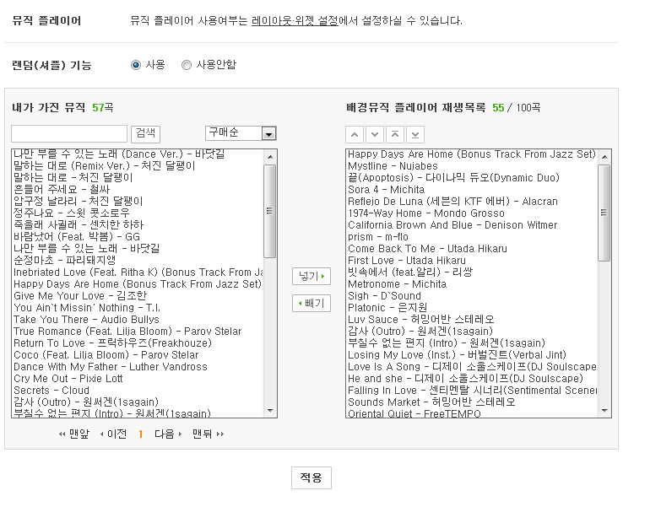
CJ E&M Library (로고)
B2B메인 바로 가기
로그아웃
바이어 관리
콘텐츠 관리
사이트 관리
관리자 관리
관리자 리스트
영화 메인화면 관리
게시물 관리
공지사항 관리
이용 가이드 관리
콘텐츠 권한 정책 관리
방송 권한 정책 관리
영화 권한 정책 관리
메인화면 관리
방송 메인화면
방송 메인팝업
영화 메인화면
영화 메인 팝업
장르 관리
방송 장르 구분
영화 장르 구분
콘텐츠 리스트 (123,333)
메인화면 노출 콘텐츠 (10)
메인화면 플레이 영상 (3)
검색
넣기 ▶
◀ 빼기
담당 지역 그룹관리
방송 담당지역 그룹관리
영화 담당지역 그룹관리
□ | 영화 제목 ▼ |  | 장르
□ | 영화 제목 ▼
□ | 좋은 놈, 나쁜 놈, 이상한 놈
□ | 아내가 거짓말을 했다
□ | 여고괴담, 세번째 이야기 - 여우괴담
□ | 맥주가 애인보다 좋은 일곱 가지 이유
□ | 가나다라마바사아자차카타파하
□ | 가나다라마바사아자차카타파하
□ | 가나다라마바사아자차카타파하
□ | 가나다라마바사아자차카타파하
□ | 가나다라마바사아자차카타파하
□ | 가나다라마바사아자차카타파하
□ | 가나다라마바사아자차카타파하
□ | 가나다라마바사아자차카타파하
□ | 가나다라마바사아자차카타파하
□ | 가나다라마바사아자차카타파하
□ | 가나다라마바사아자차카타파하
□ | 가나다라마바사아자차카타파하
□ | 가나다라마바사아자차카타파하
□ | 가나다라마바사아자차카타파하
□ | 가나다라마바사아자차카타파하
□ | 좋은 놈, 나쁜 놈, 이상한 놈
Action, Dra..
Oriental West..
Horror
Adventure
Action, Dra..
Oriental West..
Action, Dra..
Oriental West..
Action, Dra..
Oriental West..
Action, Dra..
Oriental West..
Action, Dra..
Oriental West..
Action, Dra..
Oriental West..
Action, Dra..
Oriental West..
Action, Dra..
Oriental West..
스크롤 영역
□ | 1 | 좋은 놈, 나쁜 놈, 이상한 놈
□ | 2 | 아내가 거짓말을 했다
□ | 3 | 여고괴담, 세번째 이야기 - 여우괴담
□ | 4 | 맥주가 애인보다 좋은 일곱 가지 이유
□ | 5 | 가나다라마바사아자차카타파하
□ | 6 | 가나다라마바사아자차카타파하
□ | 7 | 가나다라마바사아자차카타파하
□ | 8 | 가나다라마바사아자차카타파하가..
□ | 9 | 가나다라마바사아자차카타파하가..
□ | 10 | 가나다라마바사아자차카타파하가..
스크롤 영역
적용하기
36

Slide 37
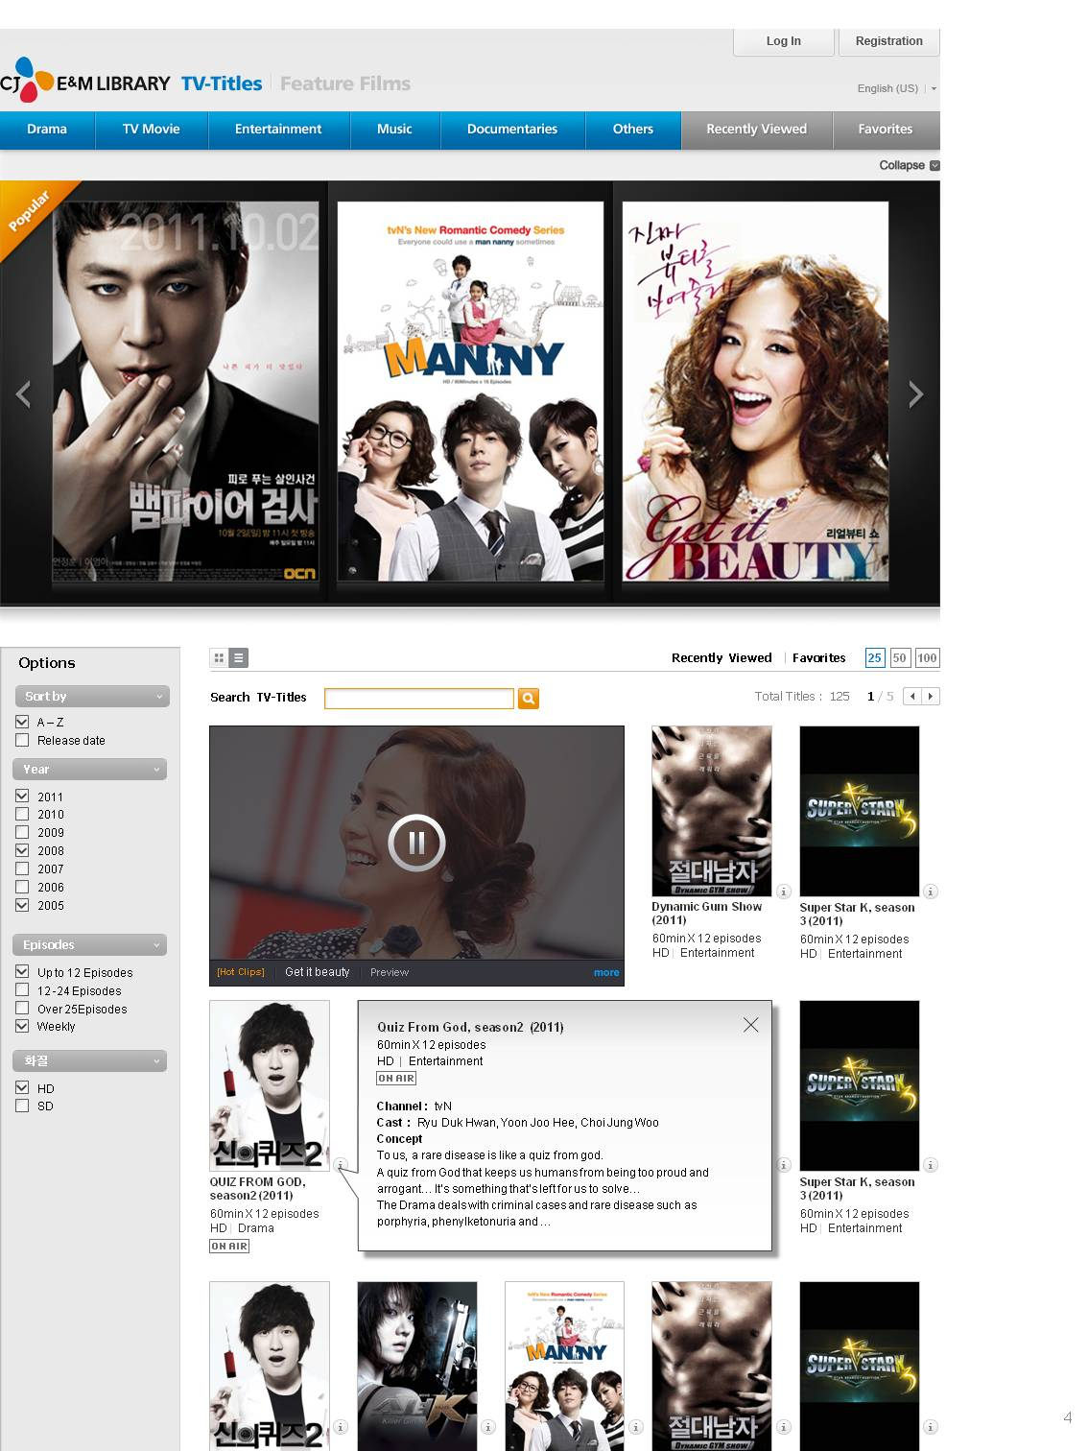
CJ E&M Library (로고)
B2B메인 바로 가기
로그아웃
바이어 관리
콘텐츠 관리
사이트 관리
관리자 관리
관리자 리스트
영화 메인화면 관리
게시물 관리
공지사항 관리
이용 가이드 관리
콘텐츠 권한 정책 관리
방송 권한 정책 관리
영화 권한 정책 관리
메인화면 관리
방송 메인화면
방송 메인팝업
영화 메인화면
영화 메인 팝업
장르 관리
방송 장르 구분
영화 장르 구분
콘텐츠 리스트 (123,333)
메인화면 노출 콘텐츠 (10)
메인화면 플레이 영상 (3)
검색
넣기 ▶
◀ 빼기
담당 지역 그룹관리
방송 담당지역 그룹관리
영화 담당지역 그룹관리
□ | 영화 제목 ▼ |  | 장르
□ | 영화 제목 ▼
□ | 좋은 놈, 나쁜 놈, 이상한 놈
□ | 아내가 거짓말을 했다
□ | 여고괴담, 세번째 이야기 - 여우괴담
□ | 맥주가 애인보다 좋은 일곱 가지 이유
□ | 가나다라마바사아자차카타파하
□ | 가나다라마바사아자차카타파하
□ | 가나다라마바사아자차카타파하
□ | 가나다라마바사아자차카타파하
□ | 가나다라마바사아자차카타파하
□ | 가나다라마바사아자차카타파하
□ | 가나다라마바사아자차카타파하
□ | 가나다라마바사아자차카타파하
□ | 가나다라마바사아자차카타파하
□ | 가나다라마바사아자차카타파하
□ | 가나다라마바사아자차카타파하
□ | 가나다라마바사아자차카타파하
□ | 가나다라마바사아자차카타파하
□ | 가나다라마바사아자차카타파하
□ | 가나다라마바사아자차카타파하
□ | 좋은 놈, 나쁜 놈, 이상한 놈
Action, Dra..
Oriental West..
Horror
Adventure
Action, Dra..
Oriental West..
Action, Dra..
Oriental West..
Action, Dra..
Oriental West..
Action, Dra..
Oriental West..
Action, Dra..
Oriental West..
Action, Dra..
Oriental West..
Action, Dra..
Oriental West..
Action, Dra..
Oriental West..
스크롤 영역
□ | 1 | 좋은 놈, 나쁜 놈, 이상한 놈
□ | 2 | 아내가 거짓말을 했다
□ | 3 | 여고괴담, 세번째 이야기 - 여우괴담
스크롤 영역
적용하기
37

Slide 38
CJ E&M Library (로고)
B2B메인 바로 가기
로그아웃
바이어 관리
콘텐츠 관리
사이트 관리
관리자 관리
관리자 리스트
제목
영화 메인화면 팝업 관리
▼
제목, 아이디
검색
전체 (123,456)
신규 작성
게시물 관리
공지사항 관리
이용 가이드 관리
 | 제목 | 작성자 ID | 작성일 ▼ | 노출기간
1120
19
18
17
16
15
14
13
12
11
10
9
8
7
6
5
4
3
2
1
가나다라마바사아자차카타파하
가나다라마바사아자차카타파하
가나다라마바사아자차카타파하
가나다라마바사아자차카타파하
가나다라마바사아자차카타파하
가나다라마바사아자차카타파하
가나다라마바사아자차카타파하
가나다라마바사아자차카타파하
가나다라마바사아자차카타파하
가나다라마바사아자차카타파하
가나다라마바사아자차카타파하
가나다라마바사아자차카타파하
가나다라마바사아자차카타파하
가나다라마바사아자차카타파하
가나다라마바사아자차카타파하
가나다라마바사아자차카타파하
가나다라마바사아자차카타파하
가나다라마바사아자차카타파하
가나다라마바사아자차카타파하
가나다라마바사아자차카타파하
abcdefg@cj.net
abcdefg@cj.net
abcdefg@cj.net
abcdefg@cj.net
abcdefg@cj.net
abcdefg@cj.net
abcdefg@cj.net
abcdefg@cj.net
abcdefg@cj.net
abcdefg@cj.net
abcdefg@cj.net
abcdefg@cj.net
abcdefg@cj.net
abcdefg@cj.net
abcdefg@cj.net
abcdefg@cj.net
abcdefg@cj.net
abcdefg@cj.net
abcdefg@cj.net
abcdefg@cj.net
0000.00.00
0000.00.00
0000.00.00
0000.00.00
0000.00.00
0000.00.00
0000.00.00
0000.00.00
0000.00.00
0000.00.00
0000.00.00
0000.00.00
0000.00.00
0000.00.00
0000.00.00
0000.00.00
0000.00.00
0000.00.00
0000.00.00
0000.00.00
0000.00.00 [00:00] ~ 0000.00.00 [00:00]
0000.00.00 [00:00] ~ 0000.00.00 [00:00]
0000.00.00 [00:00] ~ 0000.00.00 [00:00]
0000.00.00 [00:00] ~ 0000.00.00 [00:00]
0000.00.00 [00:00] ~ 0000.00.00 [00:00]
0000.00.00 [00:00] ~ 0000.00.00 [00:00]
0000.00.00 [00:00] ~ 0000.00.00 [00:00]
0000.00.00 [00:00] ~ 0000.00.00 [00:00]
0000.00.00 [00:00] ~ 0000.00.00 [00:00]
0000.00.00 [00:00] ~ 0000.00.00 [00:00]
0000.00.00 [00:00] ~ 0000.00.00 [00:00]
0000.00.00 [00:00] ~ 0000.00.00 [00:00]
0000.00.00 [00:00] ~ 0000.00.00 [00:00]
0000.00.00 [00:00] ~ 0000.00.00 [00:00]
0000.00.00 [00:00] ~ 0000.00.00 [00:00]
0000.00.00 [00:00] ~ 0000.00.00 [00:00]
0000.00.00 [00:00] ~ 0000.00.00 [00:00]
0000.00.00 [00:00] ~ 0000.00.00 [00:00]
0000.00.00 [00:00] ~ 0000.00.00 [00:00]
0000.00.00 [00:00] ~ 0000.00.00 [00:00]
ON
콘텐츠 권한 정책 관리
방송 권한 정책 관리
영화 권한 정책 관리
메인화면 팝업
ON
OFF
제목
OFF
이미지
추가
OFF
메인화면 관리
방송 메인화면
방송 메인팝업
영화 메인화면
영화 메인 팝업
Link
OFF
시작일시
0000
▼
년
00
▼
월
00
▼
일
[
00
▼
시
00
▼
분
]
OFF
종료일시
0000
▼
년
00
▼
월
00
▼
일
[
00
▼
시
00
▼
분
]
OFF
OFF
미리보기
취소
확인
OFF
장르 관리
방송 장르 구분
영화 장르 구분
OFF
OFF
OFF
담당 지역 그룹관리
방송 담당지역 그룹관리
영화 담당지역 그룹관리
OFF
OFF
OFF
OFF
OFF
OFF
OFF
Paginate
<< < 1 2 3 4 5 6 7 8 9 10 … 14 > >>
38

Slide 39
사이트 관리 >
담당지역 그룹관리

Slide 40
CJ E&M Library (로고)
B2B메인 바로 가기
로그아웃
바이어 관리
콘텐츠 관리
사이트 관리
관리자 관리
관리자 리스트
방송 | 담당지역 그룹 관리
게시물 관리
공지사항 관리
이용 가이드 관리
지역 (222) / 국가 (123,333)
B2B 지역그룹 (3)
아시아
▼
동남아시아, 유럽, 중동..
넣기 ▶
▼
◀ 빼기
+ 그룹수정
□ | 한글명 ▼ | 영문 표기 ▼
방송 지역별 그룹 (3)
콘텐츠 권한 정책 관리
방송 권한 정책 관리
영화 권한 정책 관리
스크롤 영역
□ | 한글명 ▼ | 영문 표기 ▼
□ | 그루지야 | Gruziya
□ | 네팔 | Nepal
□ | 대한민국 | Republic of Korea
□ | 동티모르 | East Timor
□ | 라오스 | Laos
□ | 레바논 | Lebanon
□ | 말레이시아 | Malaysia
□ | 몰드브 | Maldives
□ | 몽골 | Mongolia
□ | 미얀마 | Myanmar
□ | 바레인 | Bahrain
□ | 방글라데시 | Bangladesh
□ | 베트남 | Vietnam
□ | 부탄 | Bhutan
□ | 브루나이 | Brunei
□ | 사우디아라비아 | Saudi Arabia
□ | 스리랑카 | SriLanka
□ | 시리아 | Syria
□ | 싱가포르 | Singapore
□ | 아랍에미리트 | United Arab Emirates
□ | 그루지야 | Gruziya
□ | 네팔 | Nepal
□ | 대한민국 | Republic of Korea
□ | 동티모르 | East Timor
□ | 라오스 | Laos
□ | 레바논 | Lebanon
□ | 말레이시아 | Malaysia
□ | 몰드브 | Maldives
□ | 몽골 | Mongolia
□ | 미얀마 | Myanmar
□ | 바레인 | Bahrain
□ | 방글라데시 | Bangladesh
□ | 베트남 | Vietnam
□ | 부탄 | Bhutan
□ | 브루나이 | Brunei
□ | 사우디아라비아 | Saudi Arabia
□ | 스리랑카 | SriLanka
□ | 시리아 | Syria
□ | 싱가포르 | Singapore
□ | 아랍에미리트 | United Arab Emirates
스크롤 영역
아시아
삭제
유럽, 미주
삭제
메인화면 관리
방송 메인화면
방송 메인팝업
영화 메인화면
영화 메인 팝업
일본
삭제
추가
취소
확인
장르 관리
방송 장르 구분
영화 장르 구분
담당 지역 그룹관리
방송 담당지역 그룹관리
영화 담당지역 그룹관리
취소
저장하기

Slide 41
CJ E&M Library (로고)
B2B메인 바로 가기
로그아웃
바이어 관리
콘텐츠 관리
사이트 관리
관리자 관리
관리자 리스트
영화 | 담당지역 그룹 관리
게시물 관리
공지사항 관리
이용 가이드 관리
지역 (222) / 국가 (123,333)
B2B 지역그룹 (5)
아시아
▼
미주
넣기 ▶
▼
◀ 빼기
+ 그룹수정
□ | 한글명 ▼ | 영문 표기 ▼
영화 지역 그룹 (5)
콘텐츠 권한 정책 관리
방송 권한 정책 관리
영화 권한 정책 관리
스크롤 영역
□ | 한글명 ▼ | 영문 표기 ▼
□ | 그루지야 | Gruziya
□ | 네팔 | Nepal
□ | 대한민국 | Republic of Korea
□ | 동티모르 | East Timor
□ | 라오스 | Laos
□ | 레바논 | Lebanon
□ | 말레이시아 | Malaysia
□ | 몰드브 | Maldives
□ | 몽골 | Mongolia
□ | 미얀마 | Myanmar
□ | 바레인 | Bahrain
□ | 방글라데시 | Bangladesh
□ | 베트남 | Vietnam
□ | 부탄 | Bhutan
□ | 브루나이 | Brunei
□ | 사우디아라비아 | Saudi Arabia
□ | 스리랑카 | SriLanka
□ | 시리아 | Syria
□ | 싱가포르 | Singapore
□ | 아랍에미리트 | United Arab Emirates
□ | 그루지야 | Gruziya
□ | 네팔 | Nepal
□ | 대한민국 | Republic of Korea
□ | 동티모르 | East Timor
□ | 라오스 | Laos
□ | 레바논 | Lebanon
□ | 말레이시아 | Malaysia
□ | 몰드브 | Maldives
□ | 몽골 | Mongolia
□ | 미얀마 | Myanmar
□ | 바레인 | Bahrain
□ | 방글라데시 | Bangladesh
□ | 베트남 | Vietnam
□ | 부탄 | Bhutan
□ | 브루나이 | Brunei
□ | 사우디아라비아 | Saudi Arabia
□ | 스리랑카 | SriLanka
□ | 시리아 | Syria
□ | 싱가포르 | Singapore
□ | 아랍에미리트 | United Arab Emirates
스크롤 영역
삭제
삭제
메인화면 관리
방송 메인화면
방송 메인팝업
영화 메인화면
영화 메인 팝업
삭제
추가
취소
확인
장르 관리
방송 장르 구분
영화 장르 구분
담당 지역 그룹관리
방송 담당지역 그룹관리
영화 담당지역 그룹관리
취소
저장하기

